Slide 1


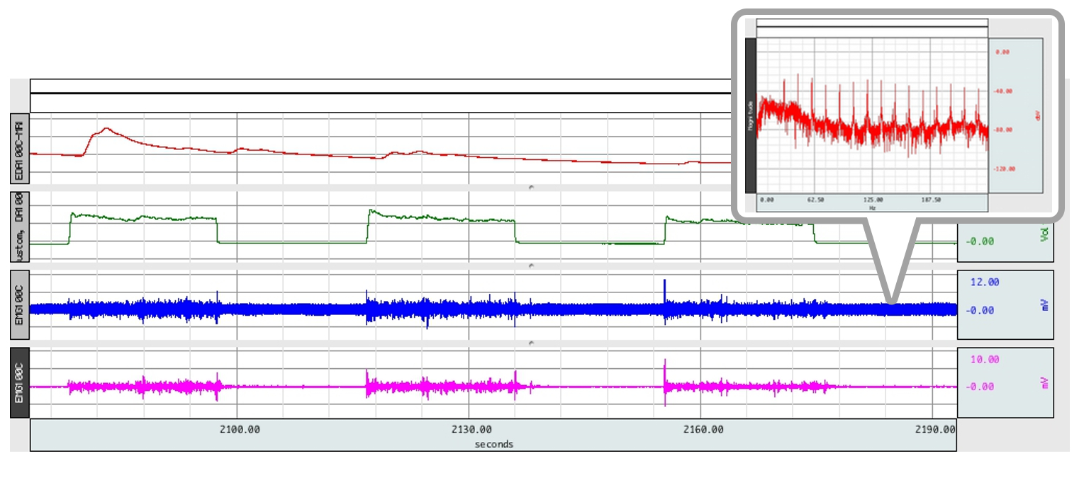
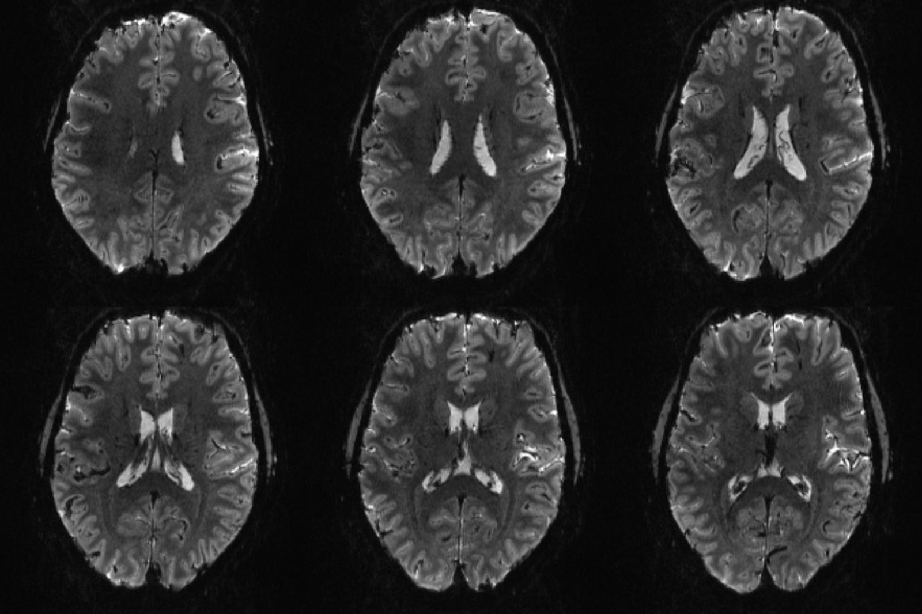
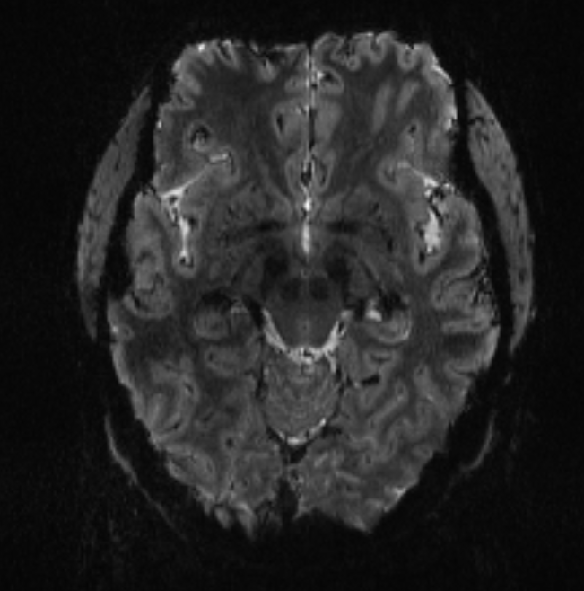
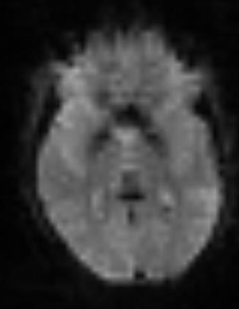
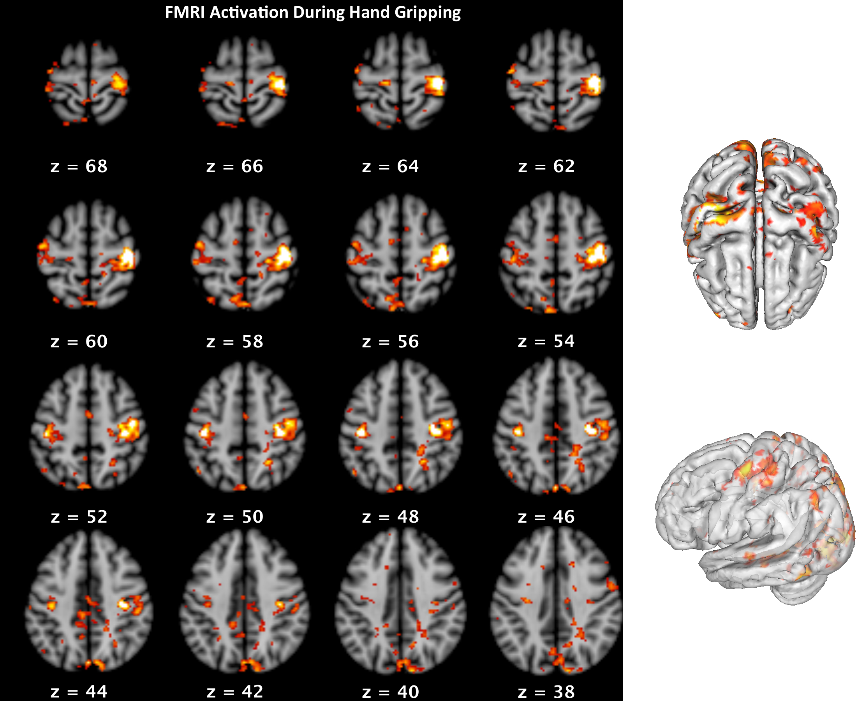
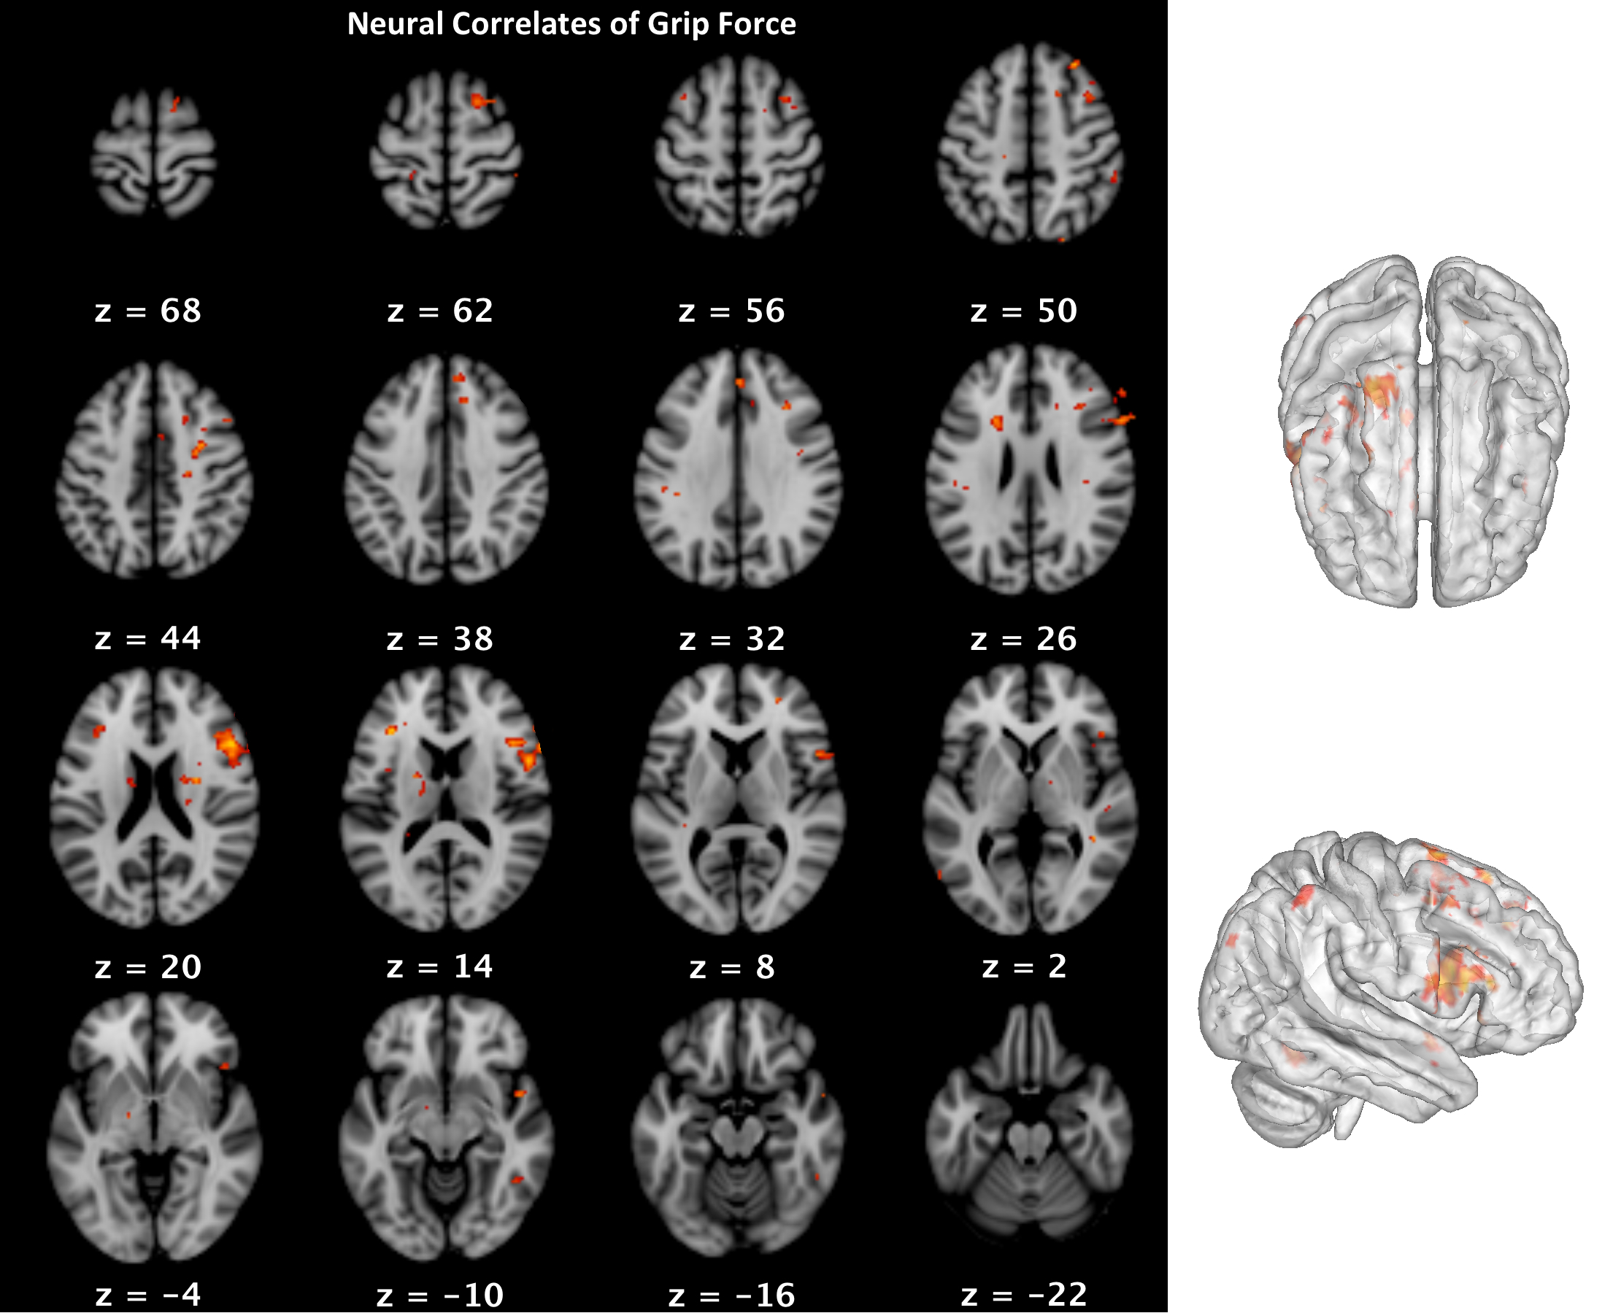
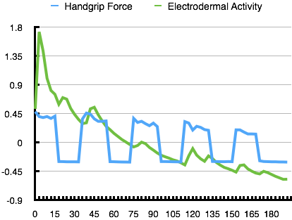
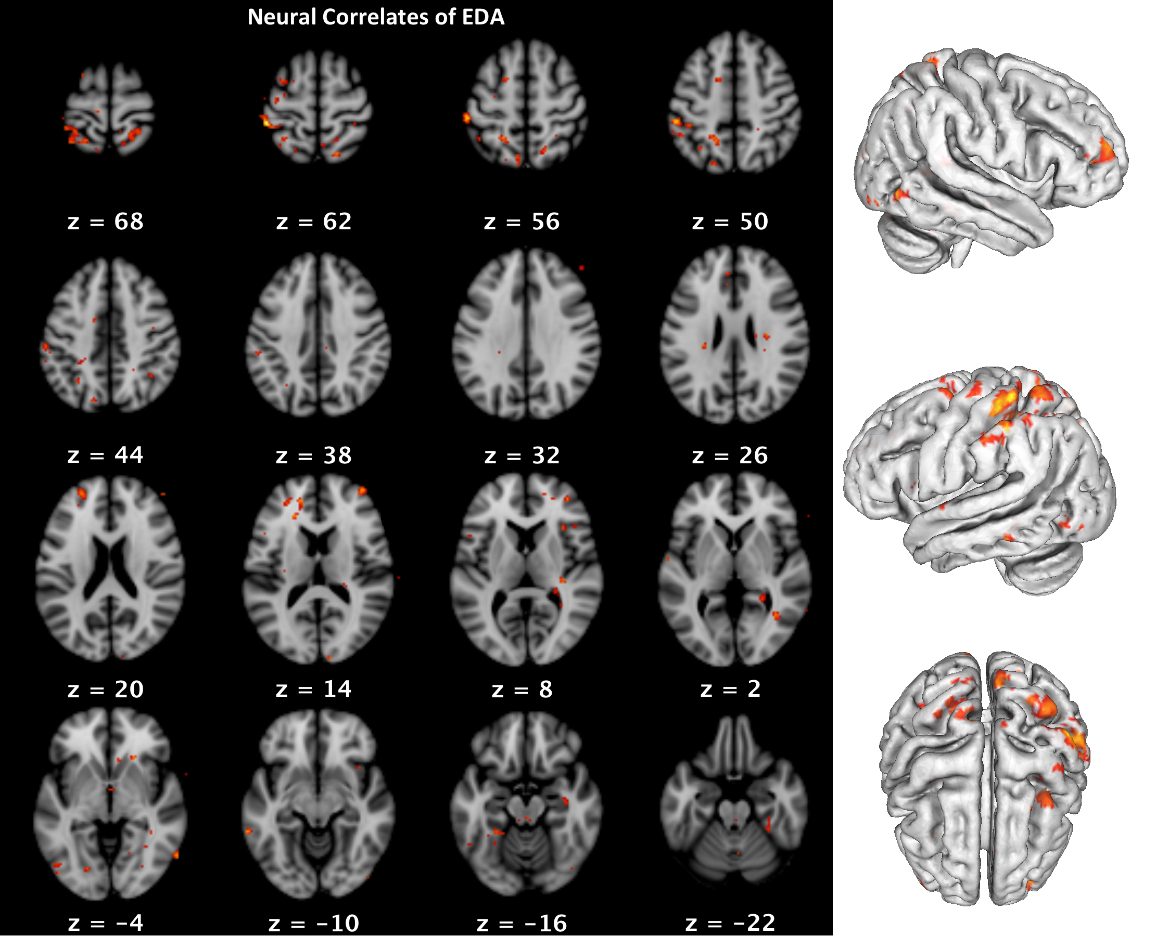
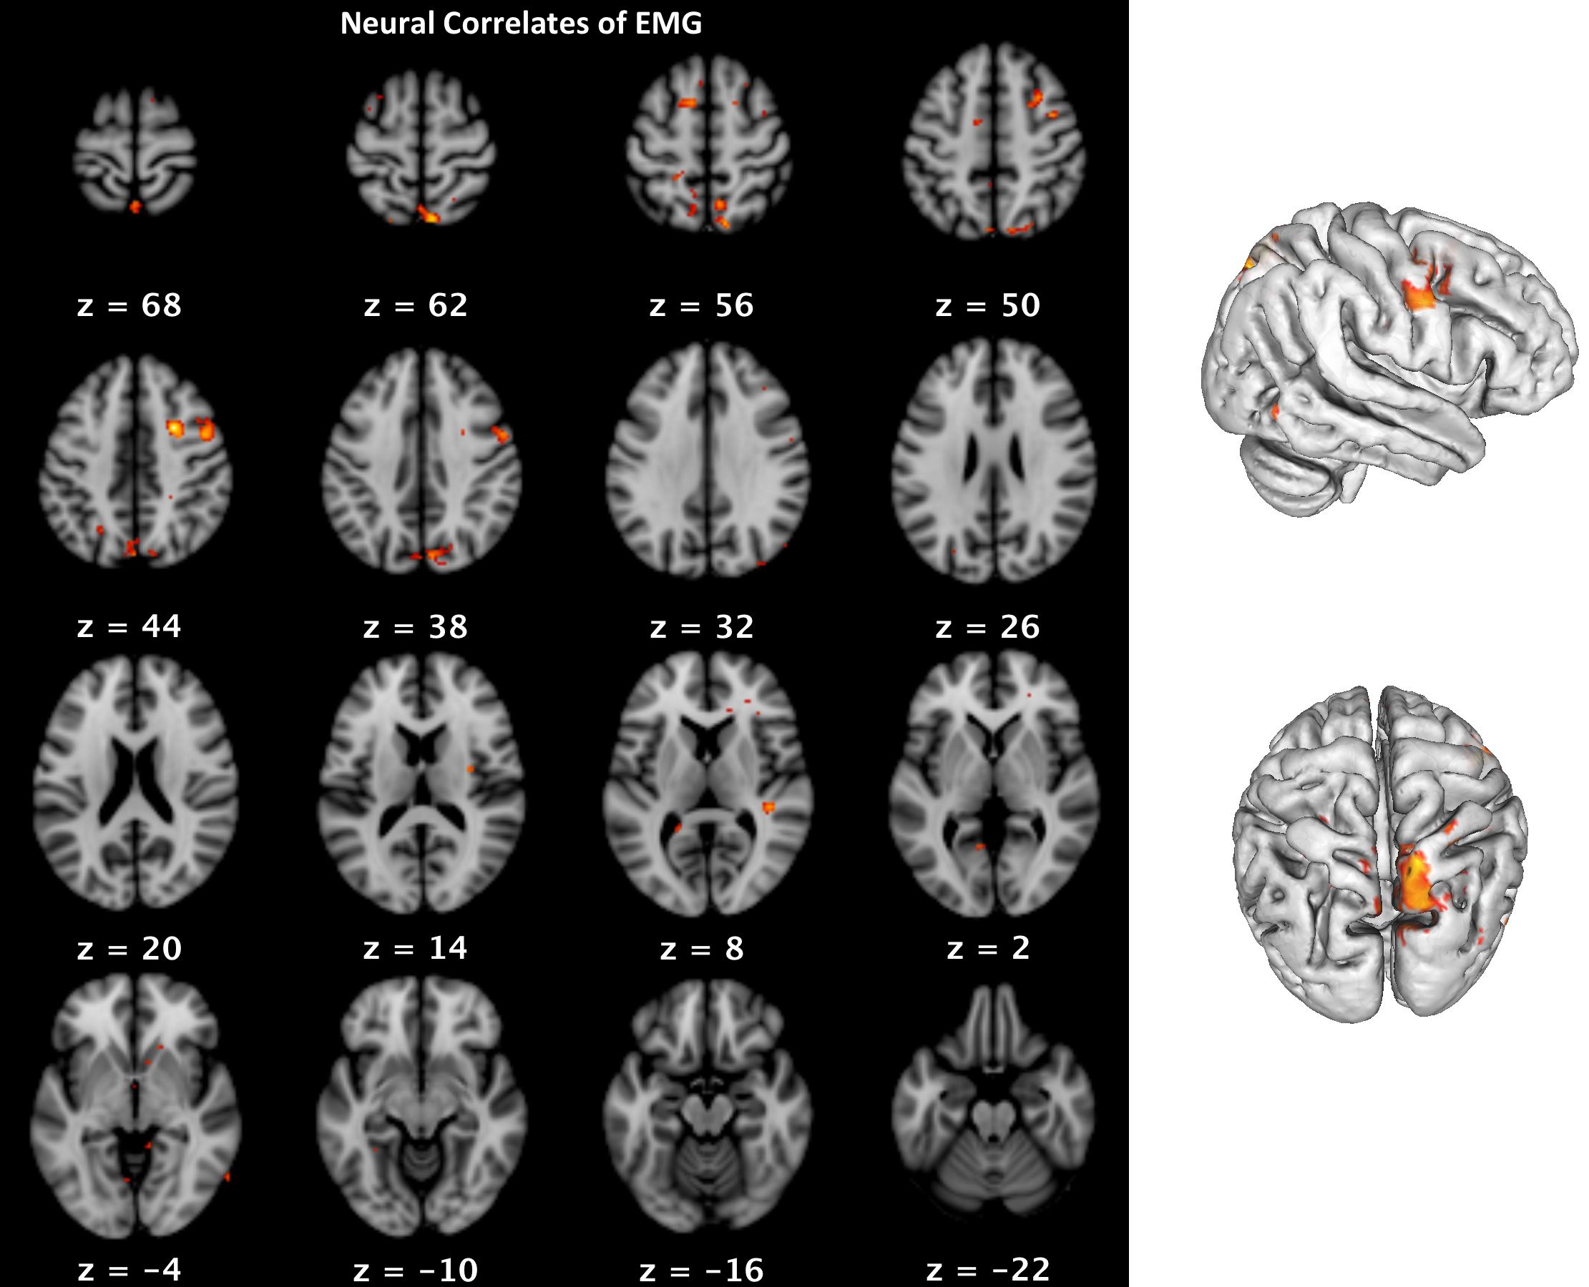
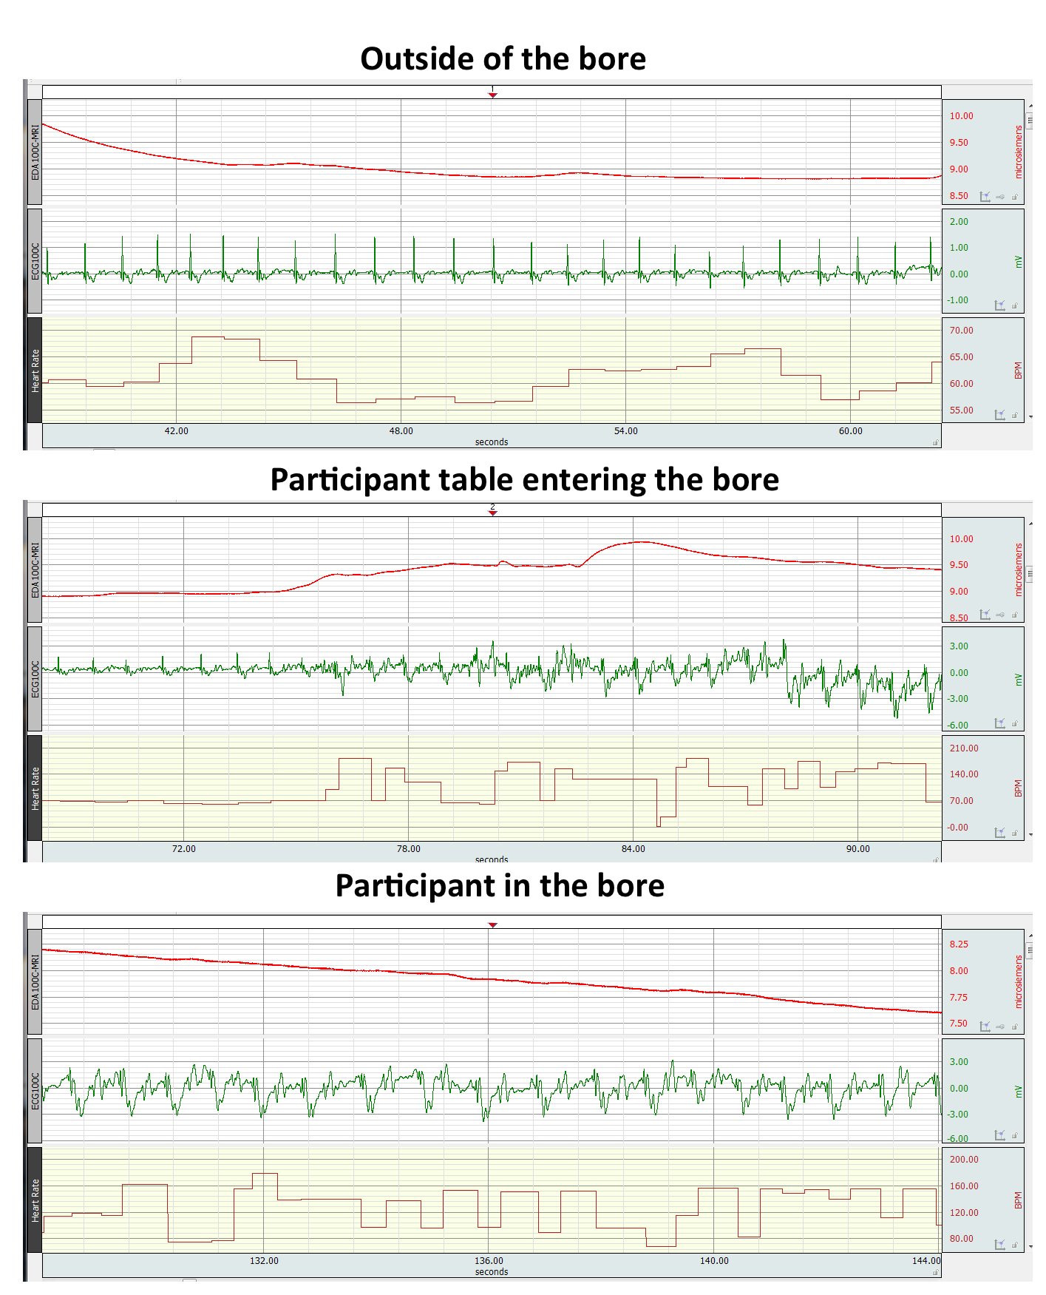

NEUROPSYCHOPHYSIOLOGICAL MAPPING: CONCOMMITANT PSYCHOPHYSIOLOGICAL RECORDING AND SUBMILLIMETER FUNCTIONAL MAGNETIC RESONANCE IMAGING (FMRI) AT 7T
Jennifer L. Robinson^{1,2,3}, Matthew W. Miller^{1,2}, Ron Beyers³, Kirk Grand², Lauren A. J. Kirby¹, Alan Macy⁴, & Ken Graap⁴
¹Department of Psychology, Auburn University, Auburn, AL, ²School of Kinesiology, Auburn University, Auburn, AL, ³Department of Electrical and Computer Engineering, Auburn University MRI Research Center, Auburn, AL, ⁴BIOPAC Systems, Inc.
          For reprint requests, please contact Jenny Robinson at jrobinson@auburn.edu
BACKGROUND
Figure 5: An example of submillimeter fMRI from this data set (left panel, and upper right panel). Note the anatomical detail compared to a 3mm standard fMRI scan (right, bottom panel).
Psychological processes engage a dynamic interaction between the peripheral and central nervous systems. However, our understanding of this interaction has been severely limited because of the lack of concomitant collection of peripheral physiological measures during functional neuroimaging. Among studies that have collected these data, they typically include one physiological measurement, and are almost exclusively carried out on 3T MRI scanners. Here, we present initial attempts at multichannel psychophysiological data collection during submillimeter 7T functional magnetic resonance imaging (fMRI) acquisition.
METHODS
Data were acquired using BIOPAC MRI-compatible modules, leads, and electrodes. FMRI scanning was carried out on a whole body 7T Siemens Magnetom scanner, outfitted with a 32-channel Nova Medical head coil. Electrocardiograph (ECG; ECG100C-MRI with EL509 electrodes, LEAD108, and GEL100), electromyograph (EMG; EMG100C-MRI), and electrodermal activity (EDA; EDA100C-MRI with EL509 electrodes, LEAD108, and GEL101) were collected during simultaneous ultra high field, high-resolution functional neuroimaging. Standard BIOPAC MEC-MRI cables were used to connect the MP150 system to the subject leads through the MRI patch panel via MRI-RFIF filters.
Psychophysiological Recording
EDA was collected from the middle and ring finger tips of the non-dominant hand. ECG electrodes were placed approximately a fist width apart on the participant’s chest, perpendicular to the magnetic field (i.e., horizontally across the heart). EMG data were recorded from the flexor digitorum superficialis and the flexor carpi radialis of the forearm during a hand grip task (BIOPAC hand dynamometer, TSD121B-MRI/DA100C). Ground electrode supplied by the negative lead of the EDA amplifier.
Scanning Parameters
fMRI Scans: 37 slices were acquired parallel to the AC-PC (0.85mmx0.85mmx1.5mm voxels, TR/TE: 3000/28ms, 70° flip angle, base/phase resolution 234/100, interleaved sequence).
Figure 2. Raw data collected during fMRI scanning. The upper panel displays raw, unfiltered EDA measurements, the second panel demonstrates the hand dynamometer grip force, the third panel displays raw, unfiltered EMG data, and the bottom panel displays the EMG data filtered with a simple comb-bandstop filter (15 Hz and up to the harmonics of the Nyquist frequency) and a 250 Hz low-pass IIR filter. The callout box displays the FFT of the period between EMG bursts, demonstrating the functional EPI artifacts that are removed following comb-bandstop filtering.
The recorded EDA data was largely unaffected by MRI scanning artifact. This data can be easily processed further by simply running it through 10 Hz IIR Low-pass filter.
The ECG data, however, was more profoundly impacted by the presence of the strong 7T magnetic field and the associated scanning artifacts. Note the ECG is highly distorted due to magneto-hydrodynamic artifact. This artifact results from the physical consequence of a conductive fluid (blood) that is moving in a magnetic field.
To automatically process such an impacted ECG for associated meta-data, such as beats per minute (BPM), over long time periods, one approach is to correlate the data with a template match to pick out ECG complexes (see Figure 4).
RESULTS
EMG, EDA, and ECG measures were derived after signal processing to remove scanning artifacts. EMG and EDA signals were reliably extracted and minimally affected by the simultaneous acquisition. ECG signals were more vulnerable to scanning parameters, and thus required more signal processing to extract.
Simply entering into the 7T magnet distorts the ECG signal substantially due to magneto-hydrodynamic effects (Figure 1), but does not appreciably effect the EDA signal.
Figure 3. Demeaned graph of the mean EDA and grip force.
Figure 4 (below). Correlation of template ECG with raw ECG (bottom panel).
Figure 1. ECG and EDA data as a participant enters the bore. The top panel displays the physiological measurements as the patient is lying on the table, with the table fully outside the scanner bore. The middle panel displays the physiological change as the participant enters into the bore (at approximately 75s, a marked distortion in the ECG signal). The bottom panel displays the effects on the physiological signals from simply being inside the bore, with no additional scanning taking place.
Figure 6 (above): Data from one subject demonstrating fMRI activation during the hand grip task as well as neural correlates of EMG, EDA, and grip force as determined by GLM analyses carried out in FSL. Psychophysiological data were extracted at TR lengths, and used as regressors of interest in whole-brain analyses. These data demonstrate proof of concept for determining potential neural underpinnings of autonomic processes.
CONCLUSIONS
We successfully collected submillimeter fMRI and multichannel psychophysiological data in an ultra-high field MR environment. Such data collection may allow for investigations that better characterize the neural and physiological processes underlying psychological constructs. Furthermore, the psychophysiological measures can be used in GLM analyses to further elucidate the contributions from the CNS to peripheral physiological measurements.
DISCLOSURE: Ken Graap and Alan Macy are employed by BIOPAC Systems, Inc., the company that developed the specialized amplifiers, transducers, cable/filter sets and physiological data acquisition system used in this study.
Session IV - 86

