Slide 1

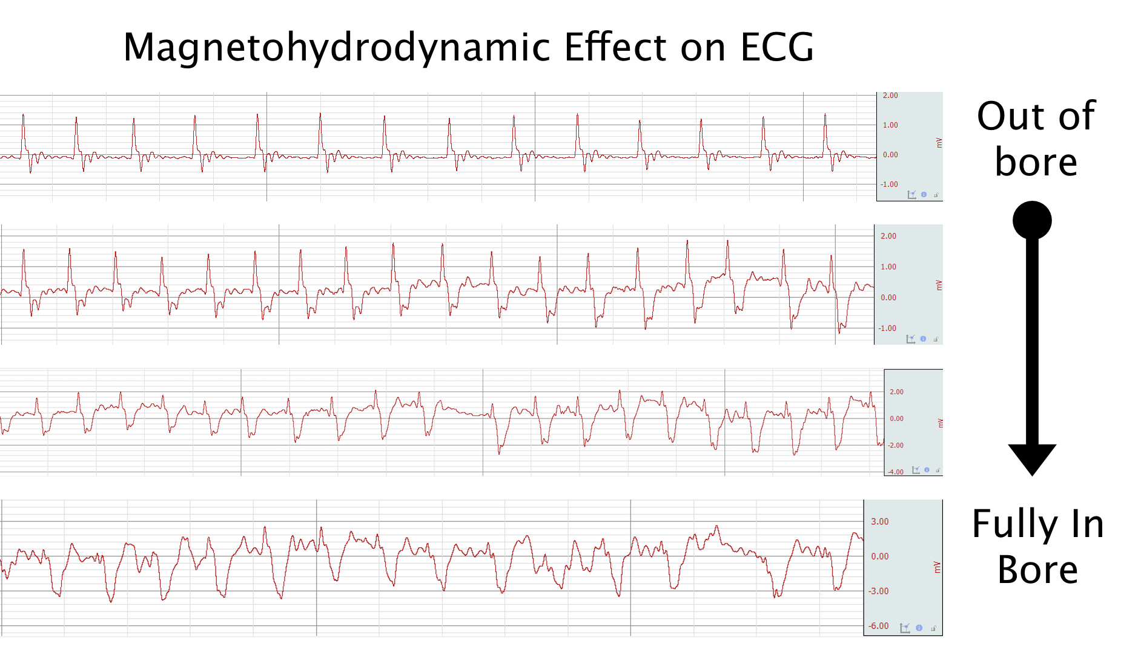
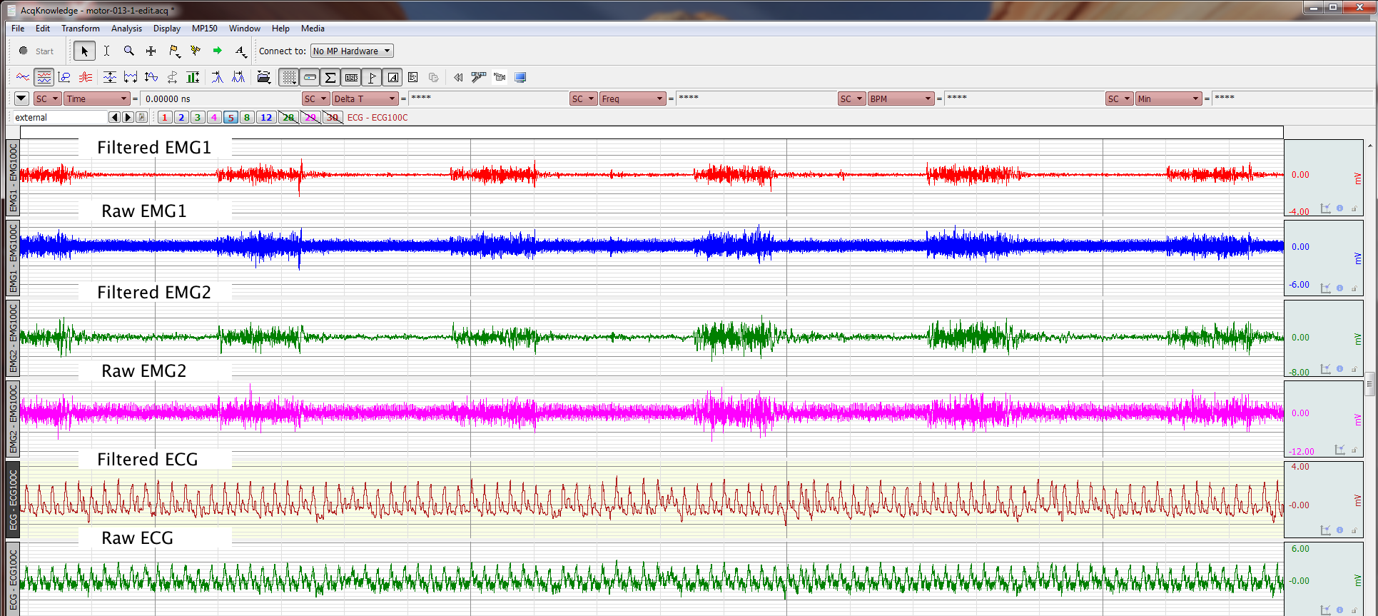
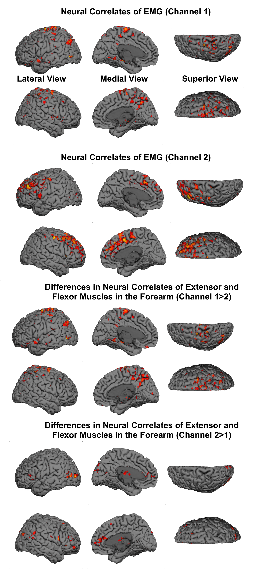
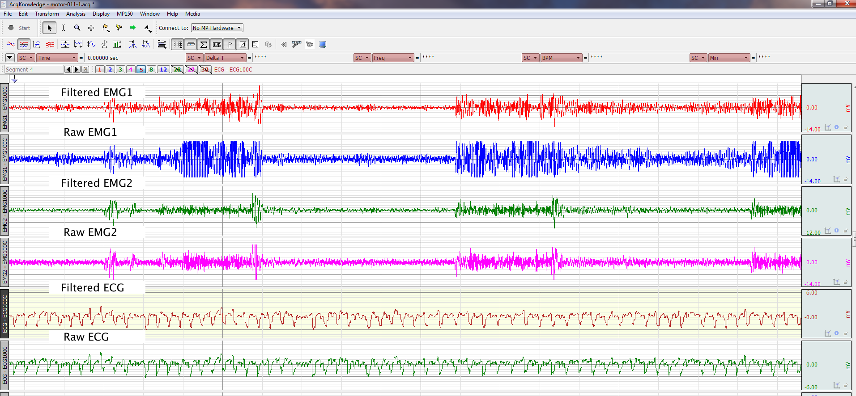
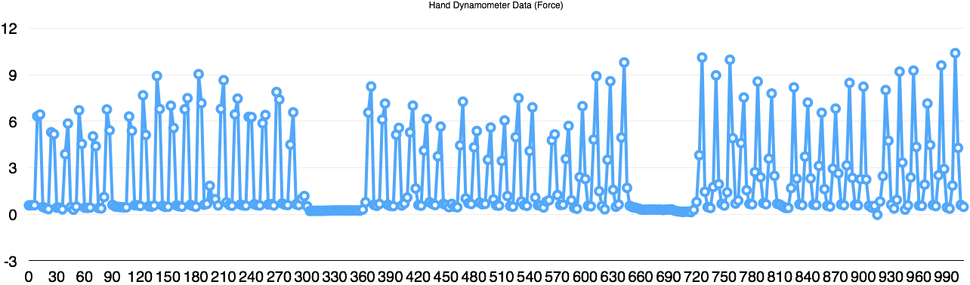
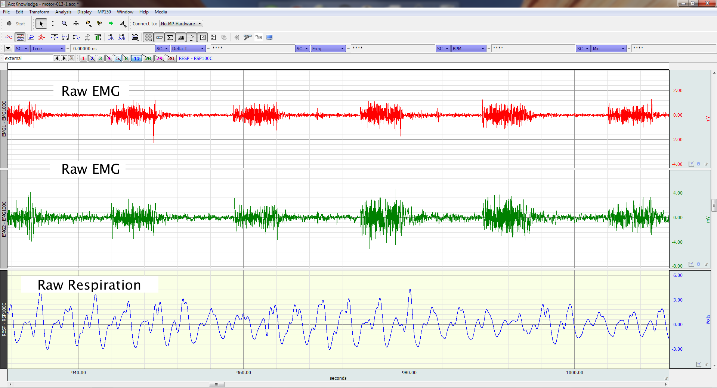
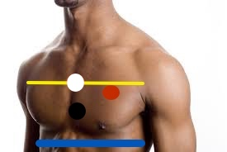
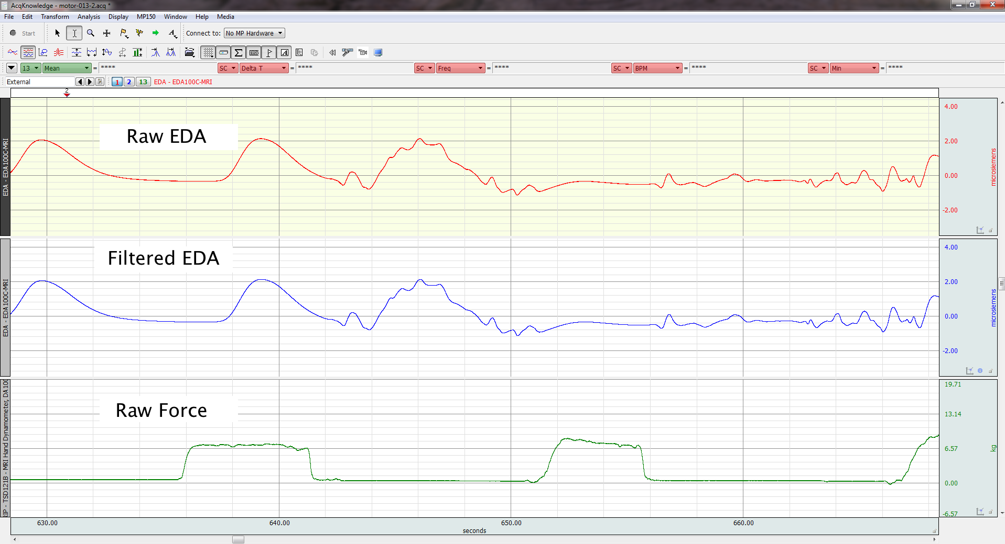
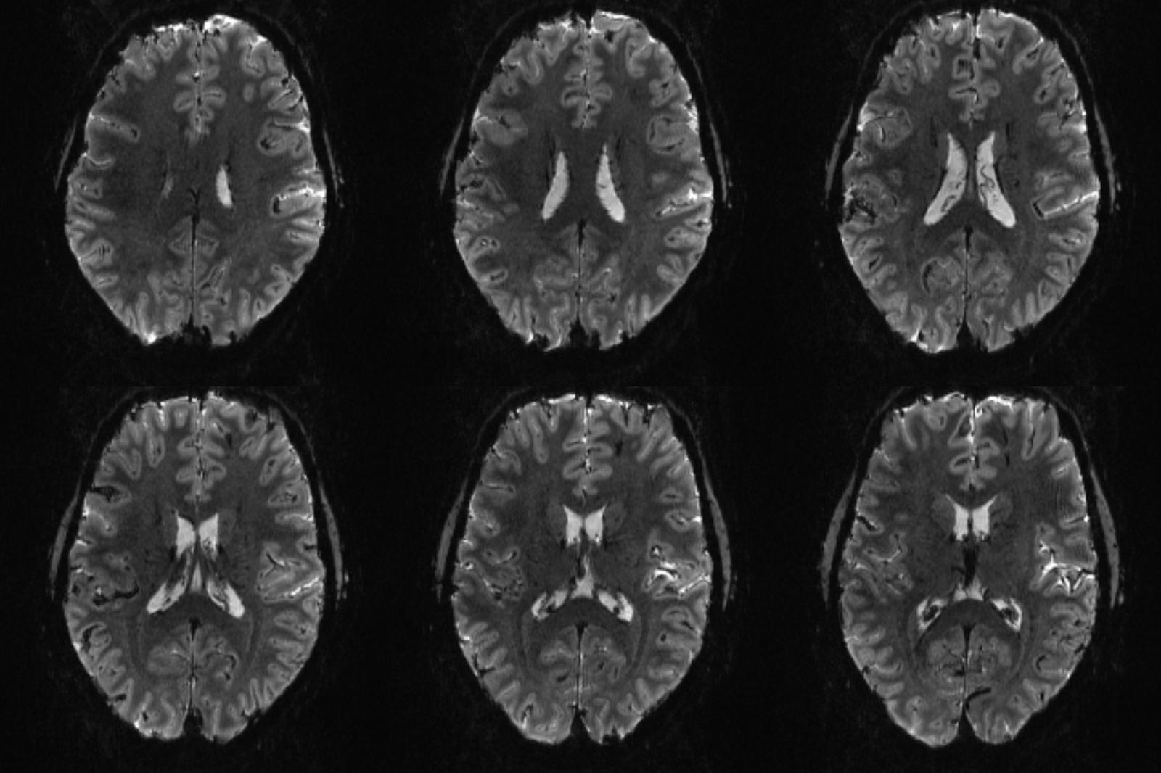
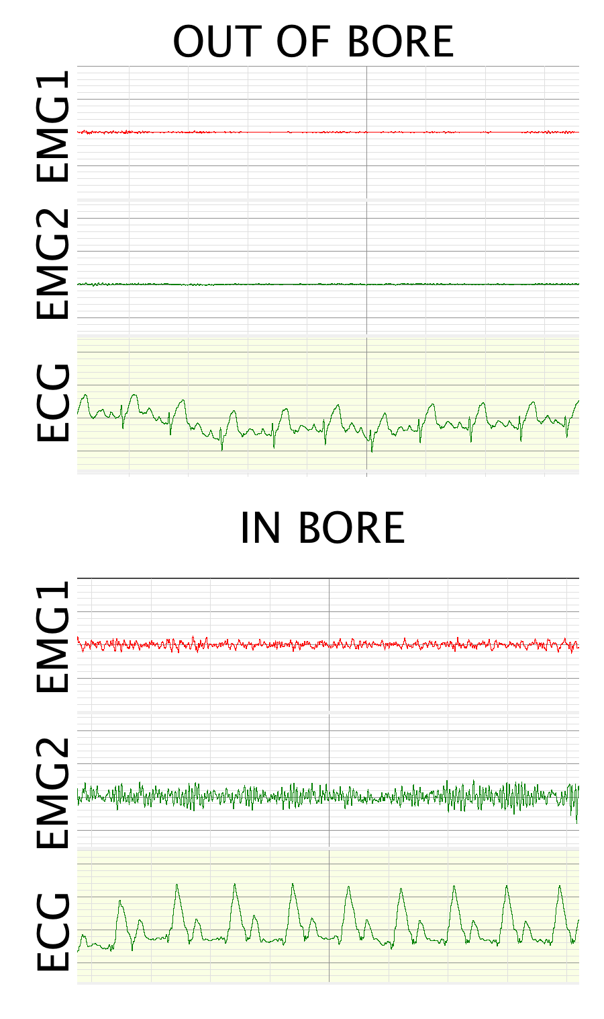
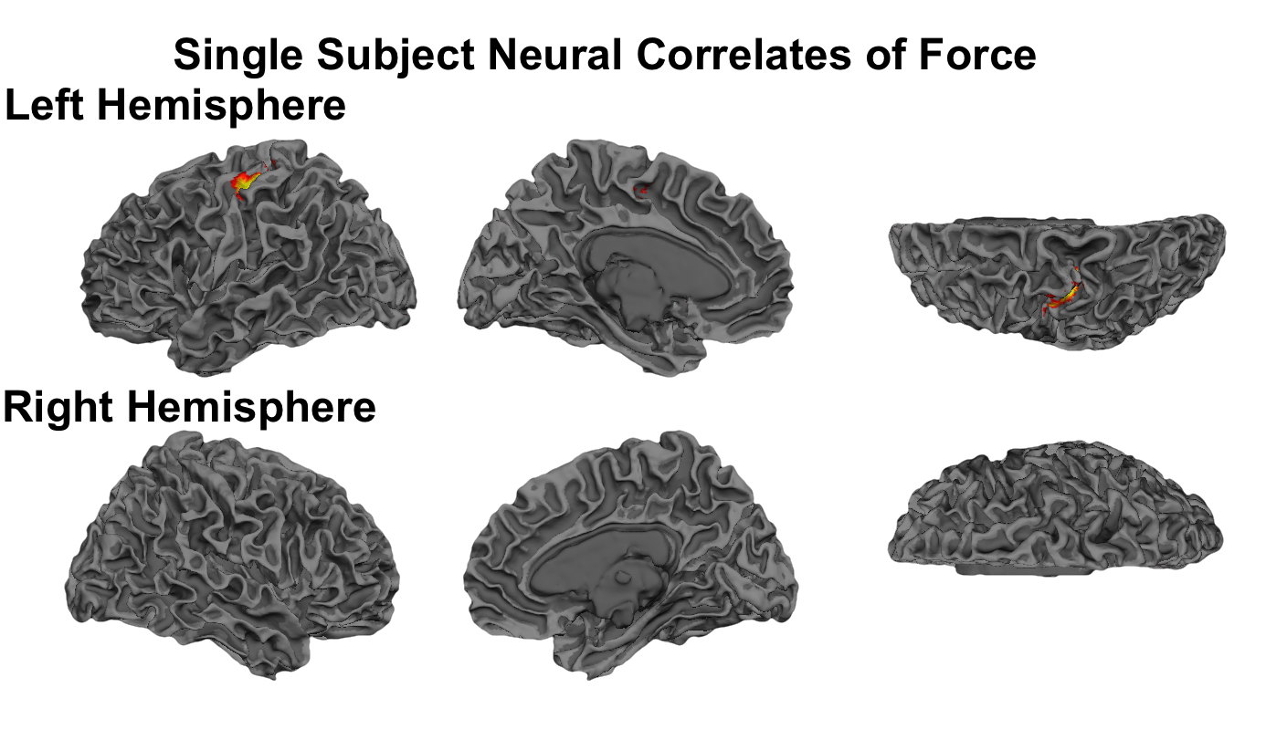
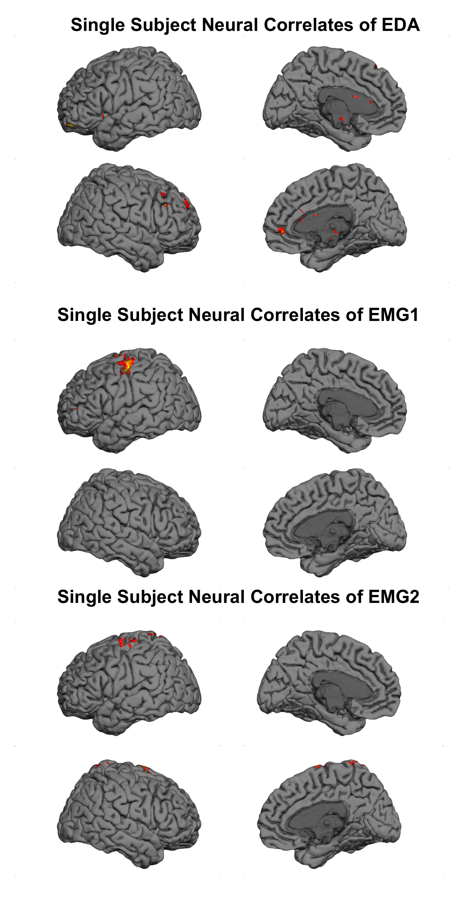
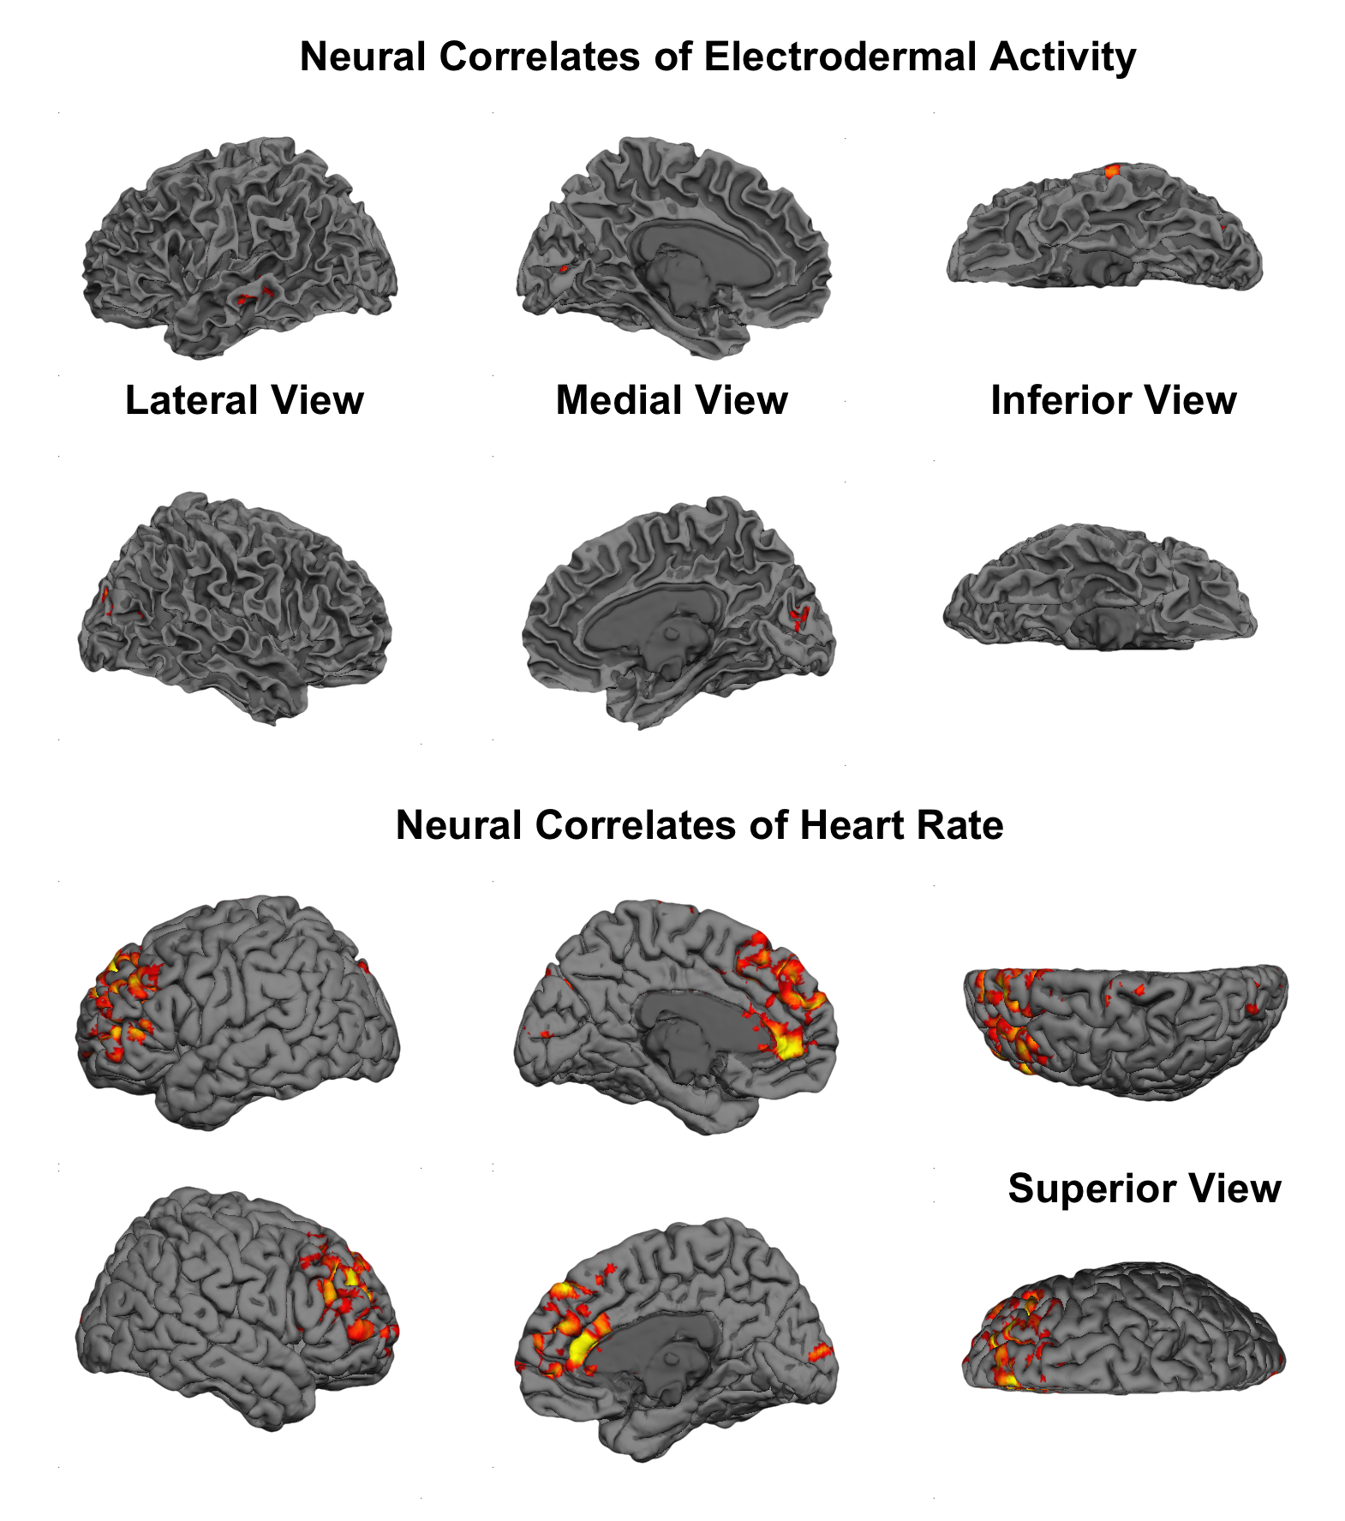
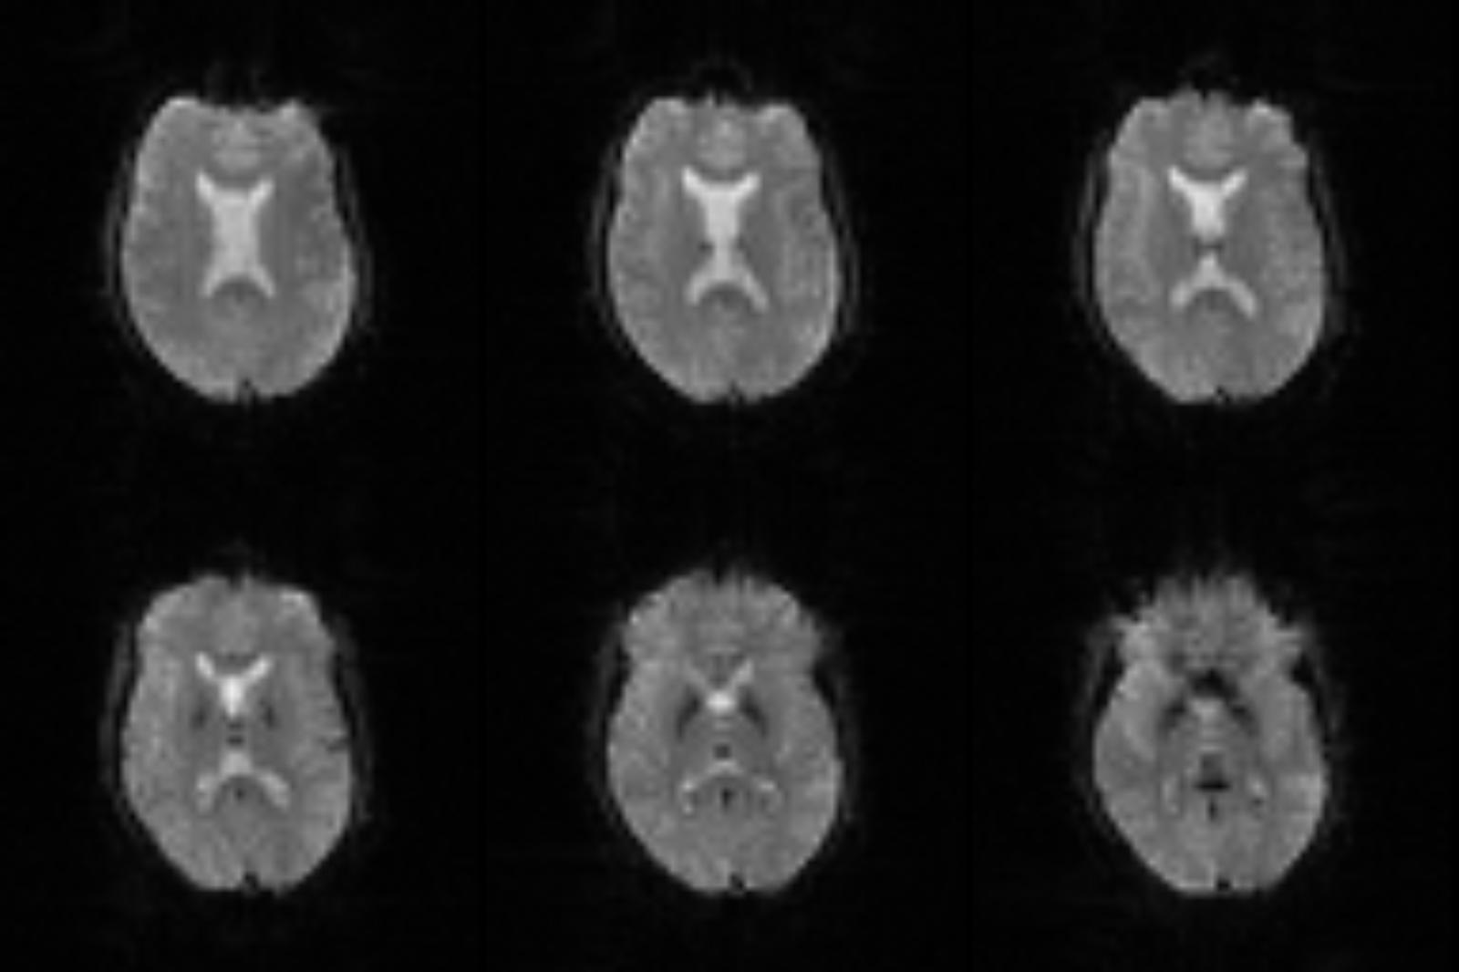
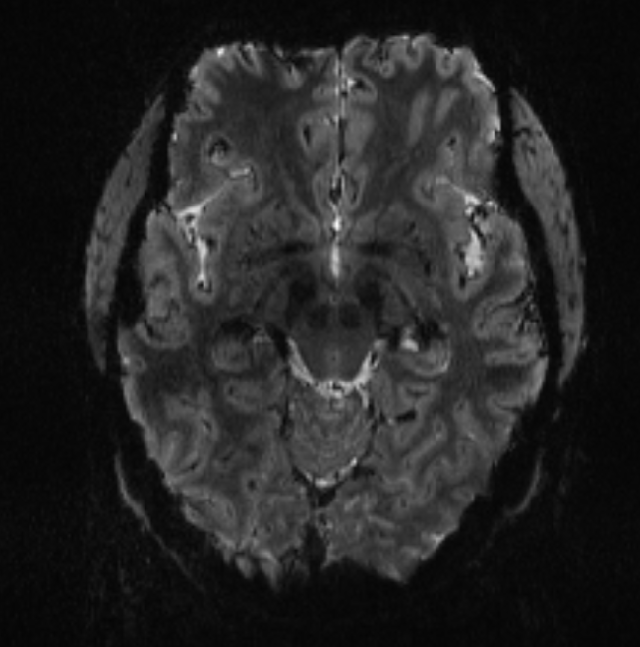
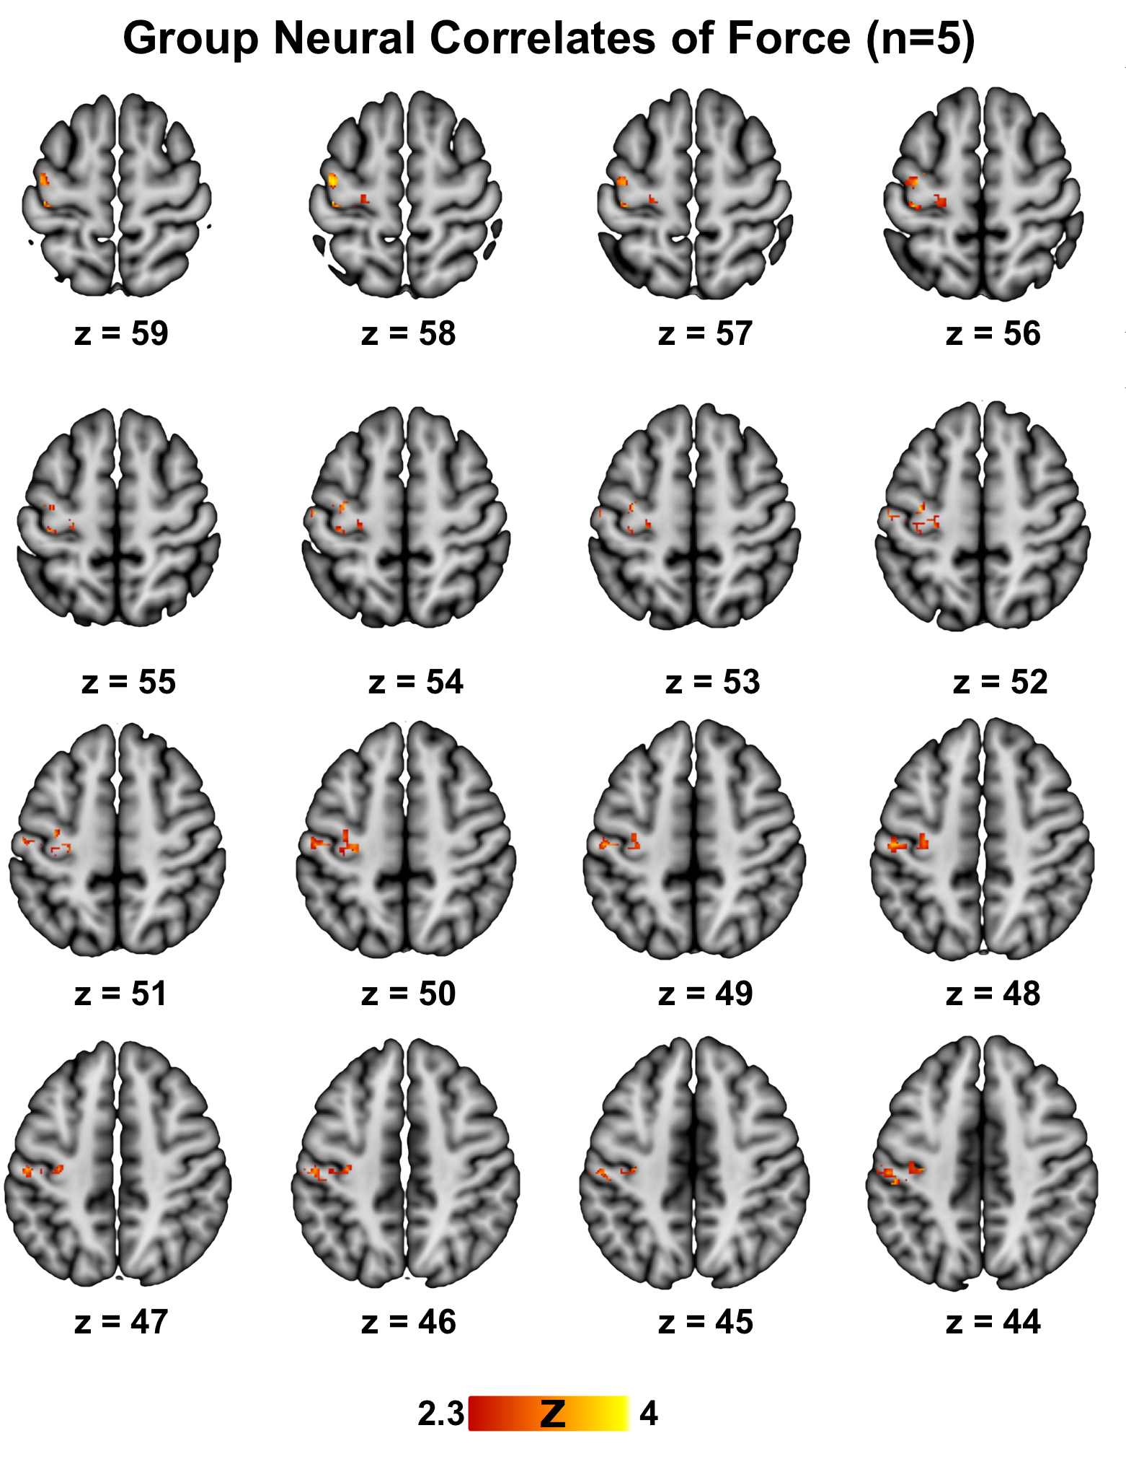
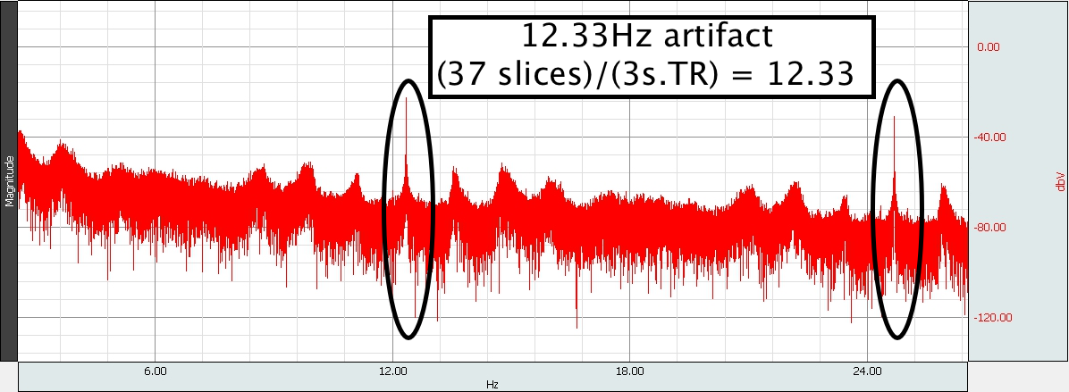
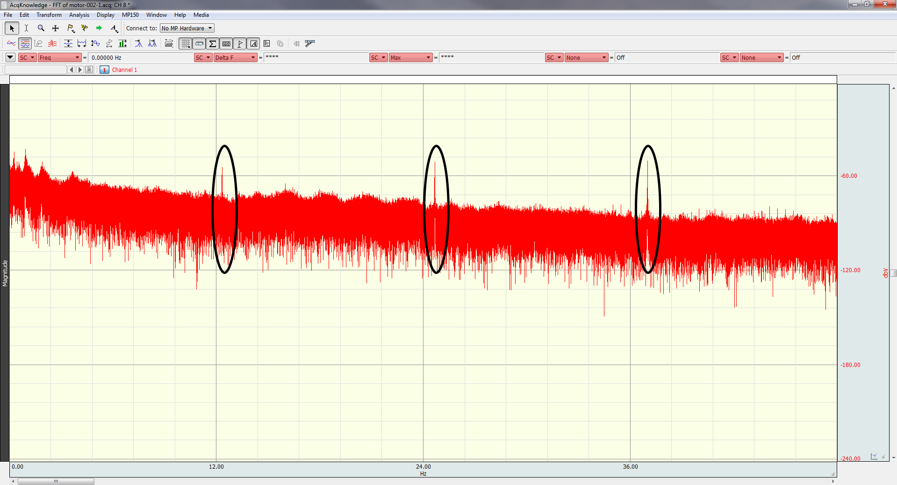


Neuropsychophysiological mapping: Concurrent psychophysiological recording and fMRI at 7T
Jennifer L. Robinson, Ph.D., Matthew Miller, Ph.D., Keith Lohse, Ph.D., Ronald Beyers, Ph.D., Kirk Grand, Lauren A. J. Kirby, Ashley C. Hill, Jerry E. Murphy, Alan Macy, M.S.E.E.*, Ken Graap, M.Ed.*
*= Author is an employee of Biopac Systems, Inc. All other authors are affiliated with Auburn University
For reprint requests, please contact Jen Robinson at jrobinson@auburn.edu
Introduction
Results
Conclusions
Psychological processes engage a dynamic interaction between the peripheral and central nervous systems. However, our understanding of this interaction has been severely limited because of the lack of concomitant collection of peripheral physiological measures during functional neuroimaging. Among studies that have collected these data, they typically include one physiological measurement, and are almost exclusively carried out on 3T MRI scanners. Here, we present initial attempts at multichannel psychophysiological data collection during submillimeter 7T functional magnetic resonance imaging (fMRI) acquisition.
EMG, EDA, and basic cardiovascular measures were derived after signal processing to remove scanning artifacts. EMG and EDA signals were reliably extracted and minimally affected by the simultaneous acquisition. For EMG data, a comb-band stop filter (12.33Hz and up to the Nyquist frequency) was applied. EDA data were subjected to a 10 Hz IIR low-pass filter to remove artifacts. Respiratory signals were largely unaffected. ECG signals were more vulnerable to scanning parameters, and highly distorted due to magnetohydrodynamic artifacts, thus a less automatic processing method was employed. Data demonstrate more specific neural correlates of muscle contraction (Figure 2 and 3), and allow for exploration of neural correlates associated with other psychophysiological measurements.
We successfully collected submillimeter fMRI and multichannel psychophysiological data in an ultra-high field MR environment. Such data collection may allow for investigations that better characterize the neural and physiological processes underlying cognition, emotion, sensation, perception, or motor tasks.
Methods
Figure 5 (left): Demonstration of the magnetohydrodynamic effect on the ECG waveform as a participant enters the bore. Figure 6 (right): Effects of filtering the data. For EMG and ECG, data are filtered with a CBSF of 12.33Hz. Heart rate data are extracted by running the “Find Rate” algorithm in AcqKnowledge, using cut-off criteria of 40 and 100 beats per minute. Data are then subjected to a Slew Rate Limiter, set to 5 beats per 1 second, to flag outlying data. Respiration, EDA, and force data are minimally affected by the magnetic field. For EDA data, we filter using an IIR low pass filter set at 10Hz. Respiration data is minimally filtered (not shown here).
Data were acquired using BIOPAC MRI-compatible modules, leads, and electrodes. FMRI scanning was carried out on a whole body 7T Siemens MAGNETOM scanner, outfitted with a 32-channel Nova Medical head coil. Electrocardiograph (ECG; ECG100C-MRI with EL509 electrodes, LEAD108, and GEL100), electromyograph (EMG; EMG100C-MRI), respiration (RSP100C with TSD201 respiratory effort transducer) and electrodermal activity (EDA; EDA100C-MRI with EL509 electrodes, LEAD108, and isotonic GEL101) were collected during simultaneous ultra high field, high-resolution functional neuroimaging. Standard BIOPAC MEC-MRI cables were used to connect the MP150 system to the subject leads through the MRI patch panel via MRI-RFIF filters. EDA was collected from the middle and ring fingers of the non-dominant hand. ECG electrodes were placed approximately a fist width apart on the participant’s chest, perpendicular to the magnetic field (i.e., horizontally across the heart). EMG data were recorded from the extensor digitorum and the flexor carpi radialis of the forearm during a hand grip task (BIOPAC hand dynamometer, TSD121B-MRI/DA100C). Respiration was collected via a respiration belt placed around the participants’ upper abdomen. The ground electrode was supplied by the negative lead of the EDA amplifier. Functional magnetic resonance imaging (fMRI) was carried out using an echo-planar sequence consisting of 37 slices acquired parallel to the AC-PC line (0.85mmx0.85mmx1.5mm voxels, TR/TE: 3000/28ms, 70° flip angle, base/phase resolution 234/100, interleaved sequence)..
Figure 7 (above): Force data from one participant. Participants were asked to squeeze the hand grip dynamometer under three conditions, each repeated 3 times, in blocks of 6 trials.
FMRI Processing
Figure 1 (left). Diagram of electrode placement for ECG. The yellow line indicates the marker we used to place the negative (white dot) electrode, which was a horizontal line from armpit to armpit. The positive electrode was placed approximately a fist away, slightly below the negative lead at a ~30 degree angle. A ground electrode was also placed parallel to the negative lead on the chest bone.
Data were processed using FSL (http://fsl.fmrib.ox.ac.uk/fsl/fslwiki/). Standard preprocessing steps were completed including brain extraction, Gaussian smoothing (5mm FWHM), and slice timing correction. Data were also motion corrected, with outliers included in subsequent GLM analyses (generated from fsl_motion_outliers). Regressors of interest were extracted physiological timecourses corresponding to the TRs. These included heart rate, electrodermal activity, 2 channels of electromyograph (extensor and flexor muscles), respiration rate, and force data.
Figure 2 (above): An example of submillimeter fMRI from this data set (upper 2 panels). Note the anatomical detail compared to a 3mm standard fMRI scan (bottom panel). Figure 3 (right): Raw data of a participant lying on the scanner table outside of the bore, and that same participant inside the bore. Figure 4 (right, lower panel): Fast-Fourier Transform (FFT) of the ECG data reveals a consistent artifact across participants of 12.33Hz, corresponding to the scanner parameters. A comb band stop filter (CBSF) was applied (fixed at 12.33Hz) to the ECG and EMG data.

