Slide 1

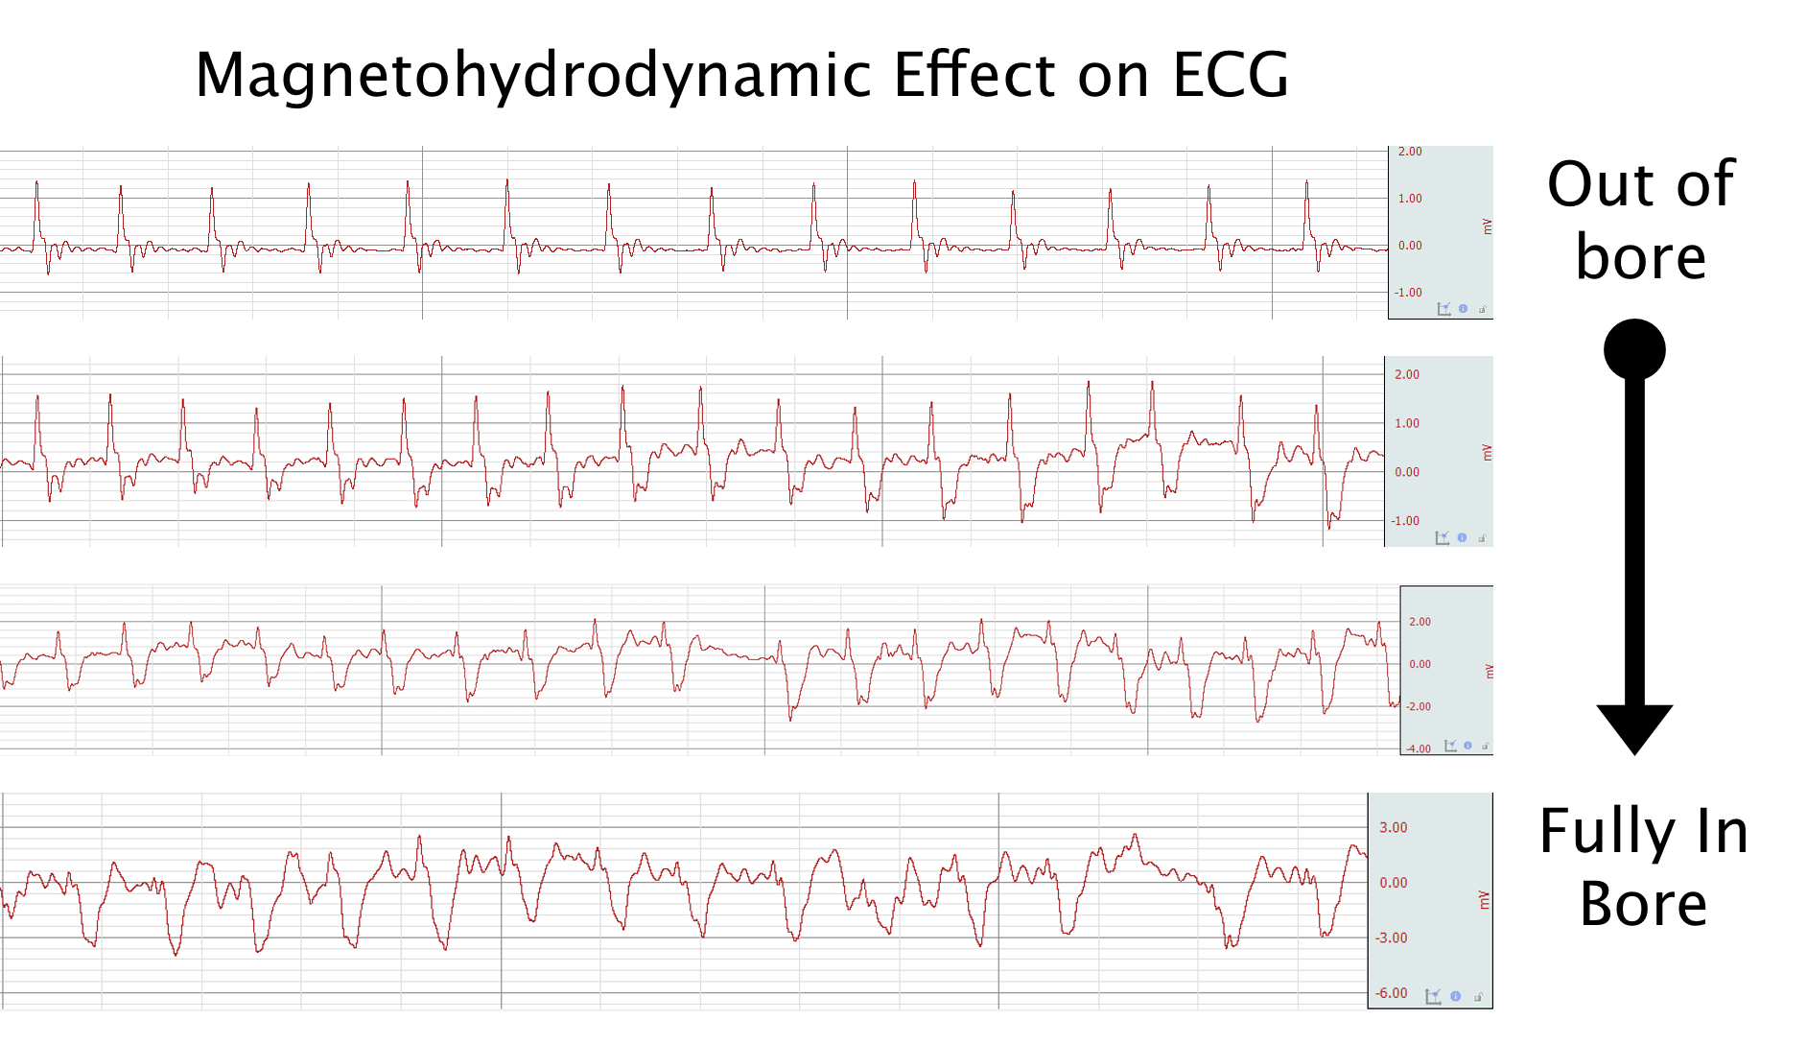
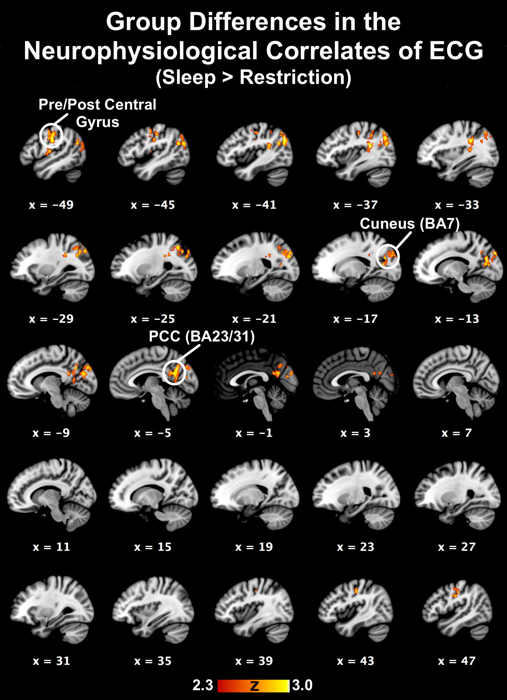
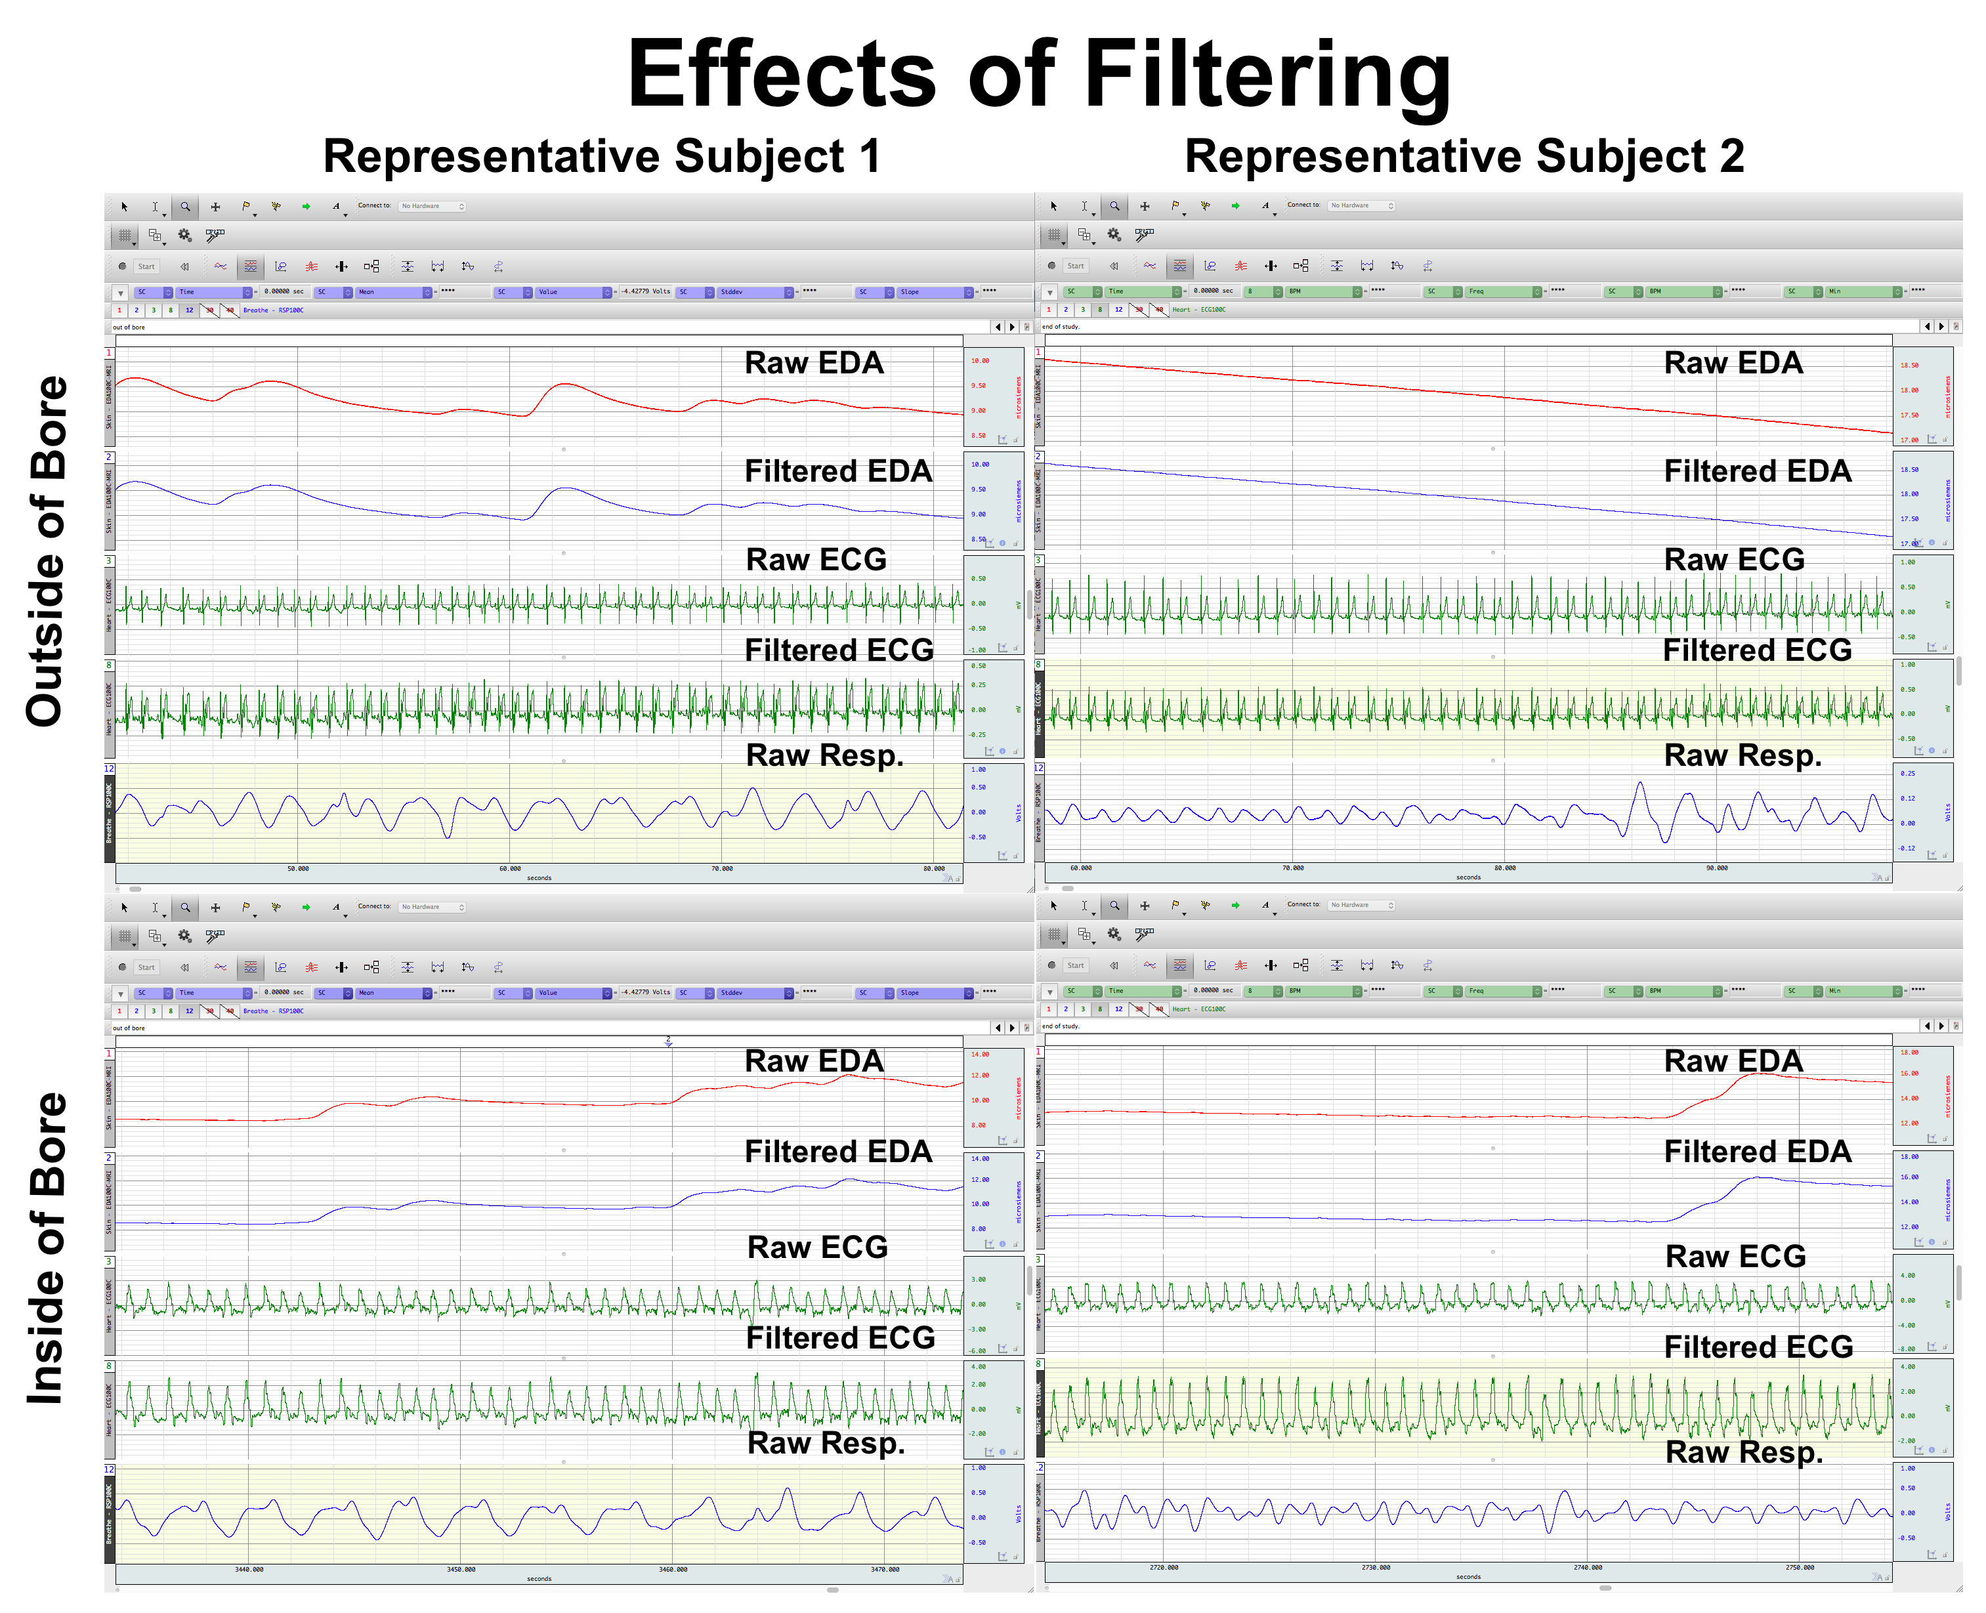

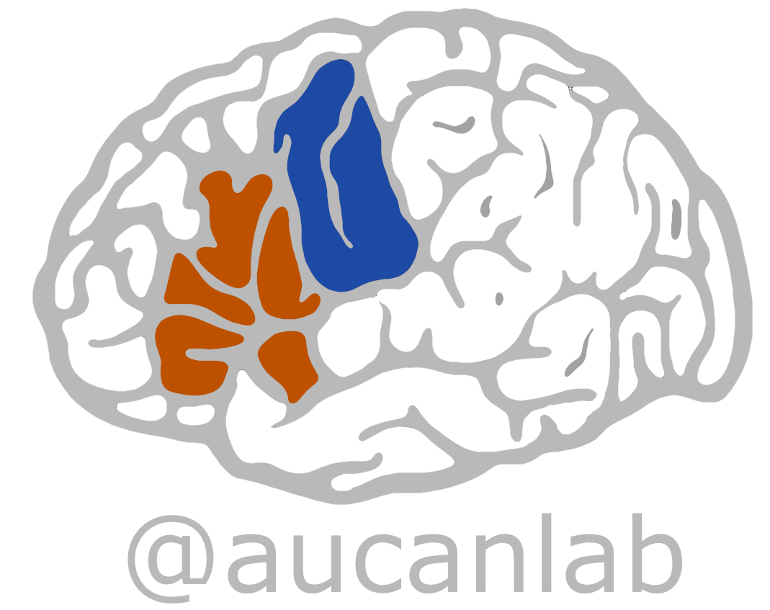
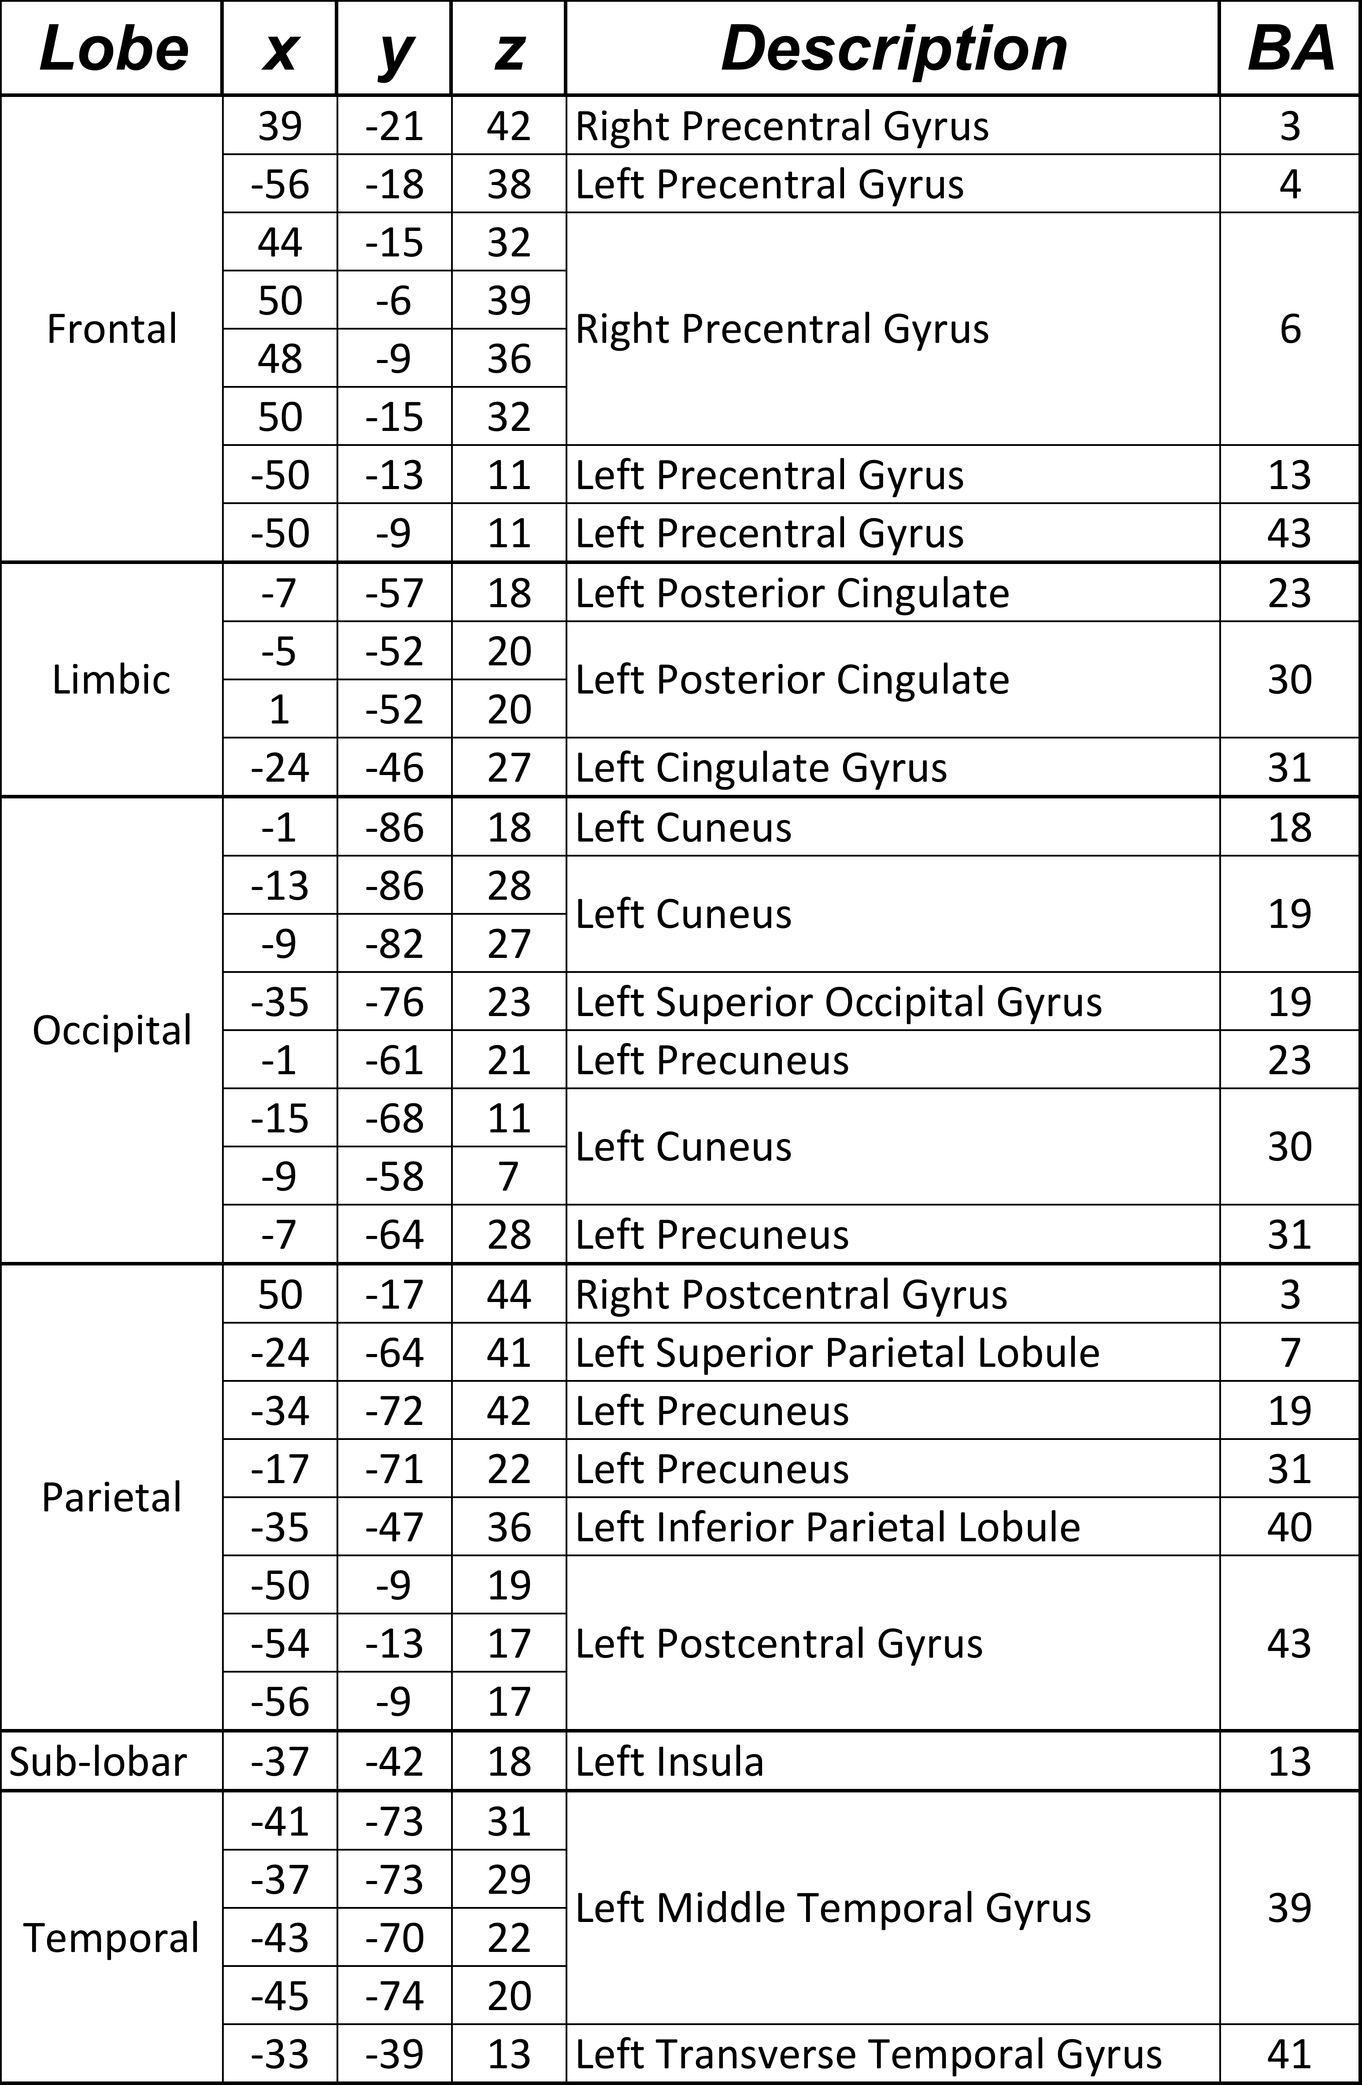
Neuropsychophysiological mapping following sleep restriction and extension: A 7T fMRI study
Jennifer L. Robinson, Ph.D., Jerry E. Murphy, Ashley C. Hill, Lauren A. J. Kirby, Anna Kirkland, Cade Loftin, Ken Graap, M.Ed.*, Alan Macy, M.S.E.E.*, Stephen A. Erath, Ph.D., & Mona El-Sheikh, Ph.D.
*= Author is an employee of Biopac Systems, Inc. All other authors are affiliated with Auburn University.
For reprint requests, please contact Jen Robinson at jrobinson@auburn.edu
BACKGROUND
PSYCHOPHYSIOLOGICAL PROCESSING
RESULTS
Sleep deprivation has been demonstrated to have a tremendous impact on peripheral and central nervous system function. However, our understanding of this interaction has been severely limited because of the lack of concomitant collection of peripheral physiological measures during functional magnetic resonance imaging (fMRI). Here, we present initial attempts at multichannel psychophysiological data collection during submillimeter 7T fMRI during cognitive performance following sleep restriction and extension.
Overarching Study Objectives
Using a within-subject experimental design, we examined whether acute sleep restriction in typically developing young adolescents contributes to differential cortical and limbic activity (measured by fMRI) in resting state networks & during behavioral tasks. In addition, we sought to understand the contributions of the brain on peripheral nervous system measures.
EMG, EDA, and basic cardiovascular measures were derived after signal processing to remove scanning artifacts. EMG and EDA signals were reliably extracted and minimally affected by the simultaneous acquisition. For EMG data, a comb-band stop filter (12.33Hz and up to the Nyquist frequency) was applied. EDA data were subjected to a 10 Hz IIR low-pass filter to remove artifacts. Respiratory signals were largely unaffected. ECG signals were more vulnerable to scanning parameters, and highly distorted due to magnetohydrodynamic artifacts, thus a less automatic processing method was employed.
FMRI Differences in the BART Task. During successful vs. unsuccessful trials, youth who had a normal night’s sleep engaged the cingulate cortex more than after a night of sleep restriction. In contrast, compared to when they slept longer, sleep deprived youth had greater activation in the left amygdala, insula, and putamen on trials when they were unsuccessful (balloon popped) versus successful. (Data not shown here)
FMRI Differences in Neuropsychophysiological Correlates. The only psychophysiological measurement that demonstrated differences in neural correlates between conditions (i.e., sleep versus sleep deprivation) was ECG. Specifically, the posterior cingulate (PCC; Brodmann Area [BA] 23/30/31), insula (BA 13), regions of the pre- and post-central gyri, and the precuneus/cuneus were all associated with ECG signals more so following normal sleep compared to restricted sleep, suggesting that following a normal night’s sleep, cardiovascular autonomic control may be modulated by regions involved in cognitive processing and interoception.
METHODS
Study Design
7 youth participated in 2 experimental conditions (Fridays), counterbalanced, one week apart.
Sleep Restriction: 4 hours in bed (2-6 AM for 8 AM scans; 3-7 AM for 9 AM scans)
“Normal Sleep”: 8 hours in bed (10 PM – 6 AM or 11 PM - 7 AM)
Actigraphy-based and research assistant manipulation checks
  Research assistants phoned the adolescents every 30 minutes when they were instructed to stay awake (sleep restriction) and woke them up at the specified time
  Actigraphy data verified adherence to the protocol
Each sleep manipulation followed by an fMRI scan the next morning (Saturdays)
Data presented in this poster only presents results from a single behavioral risk-taking task.
Psychophysiology. Data were using BIOPAC MRI-compatible modules, leads, and electrodes. Electrocardiograph (ECG), respiration, and electrodermal activity (EDA) were collected during simultaneous high-resolution (i.e., submillimeter) fMRI. Respiration, EDA, and basic cardiovascular measures were derived after signal processing to remove scanning artifacts. EDA and respiration signals were reliably extracted and minimally affected by the simultaneous acquisition. ECG signals were more vulnerable to scanning parameters, and thus more difficult to extract.
FMRI Scanning. Scanning was carried out on a Siemens 7T MAGNETOM scanner with 32-channel head coil. All functional scanning sequences had the following parameters: 37 slices acquired parallel to the AC-PC line, 0.85mmx0.85mmx1.5mm voxels, TR/TE: 3000/28ms, 70° flip angle, base/phase resolution 234/100, A>P phase-encode direction, iPAT GRAPPA acceleration factor = 3, interleaved acquisition.
Balloon Analogue Risk-Taking Task (BART)
BART is a computerized measure of risk taking behavior and has sensitivity in determining neural network differences in populations with varying levels of risk-sensitivity.
Networks associated with the BART include the amygdala, caudate and putamen, involved in the processing of reward-relevant stimuli, and implicated in aberrant functioning in sleep-deprived populations (Bell-McGinty et al., 2004).
Youth are presented with a balloon that they can pump up to earn points. The balloon can ‘pop’ at any time and the more the balloon inflates, the more points they earn. They can stop inflating the balloon and collect the points earned for that trial at any time. If the balloon pops, the points earned from that trial are lost. Youth are not informed about the balloons breakpoints, which occur at random.
The task lasted 6 min (120 volumes collected).
CONCLUSIONS
Data reveal neuropsychophysiological correlates of peripheral autonomic signals, dependent on the context (sleep versus sleep deprivation). These data are interpreted with caution given the small sample in this preliminary report. However, we successfully demonstrate collection of submillimeter fMRI and multichannel psychophysiological data in an ultra-high field MR environment in adolescents under two conditions. Such data collection may allow for investigations that better characterize the neural and physiological processes underlying psychological constructs.
Although not presented in this poster, we have now collected over 40 sessions of concomitant fMRI and psychophysiological measurements at ultra-high field in adolescents, with no adverse effects.
FMRI PROCESSING
Data were processed using FSL (http://fsl.fmrib.ox.ac.uk/fsl/fslwiki/). Standard preprocessing steps were completed including brain extraction, Gaussian smoothing (5mm FWHM), and slice timing correction. Data were also motion corrected, with outliers removed from subsequent GLM analyses (generated from fsl_motion_outliers). Regressors of interest were extracted physiological timecourses corresponding to the TRs. These included ECG, EDA, and respiration. Group analyses were performed, controlling for within-subjects effects. Data were thresholded at cluster and voxel FDR-corrected p<0.05.

