Slide 1

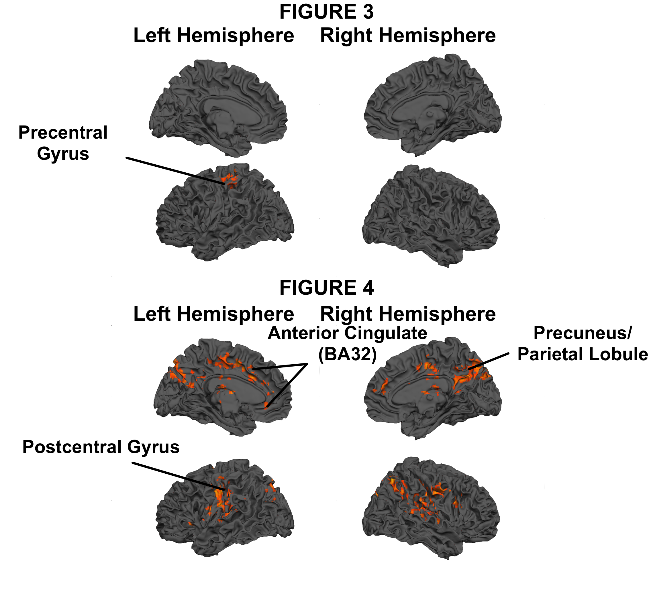
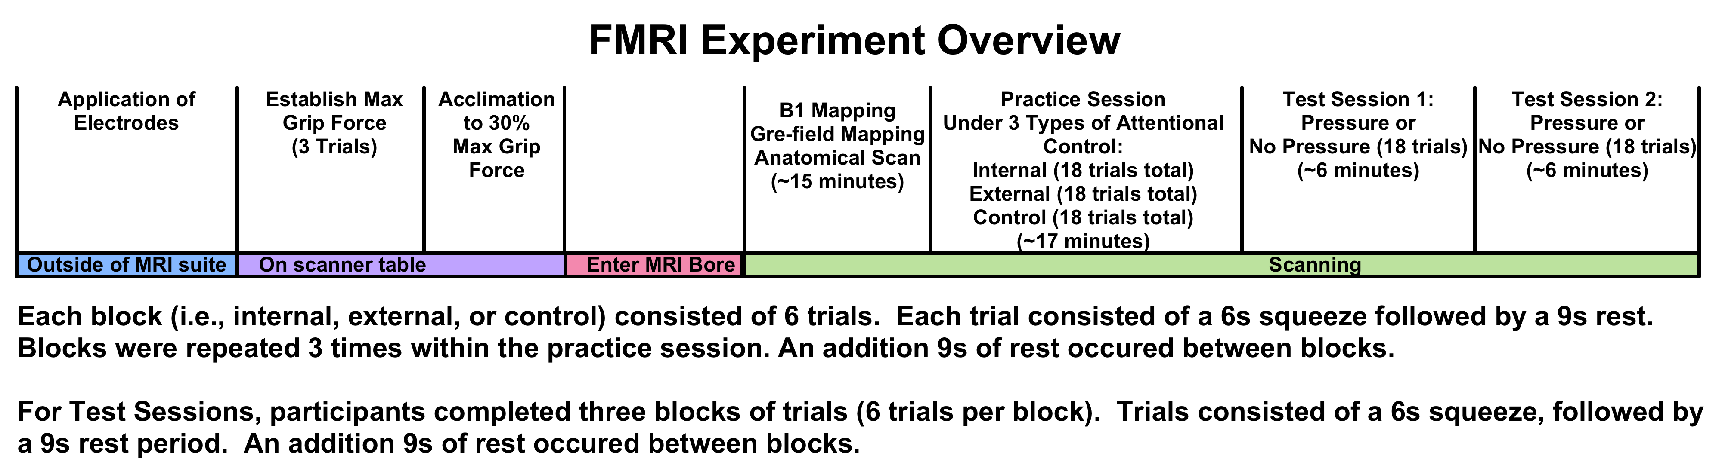
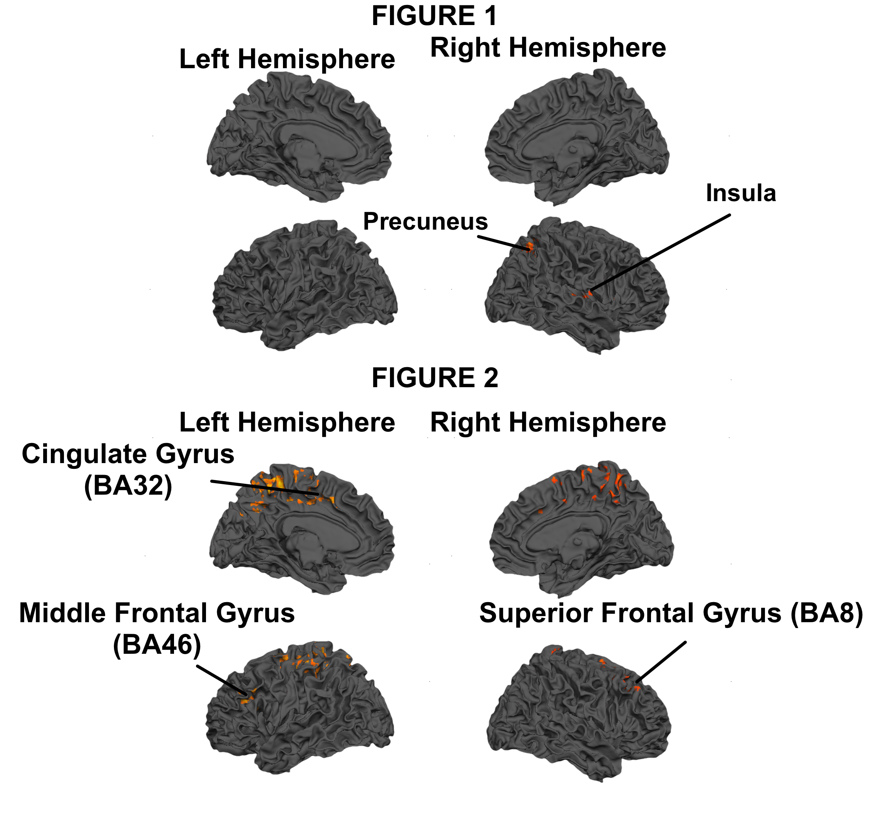
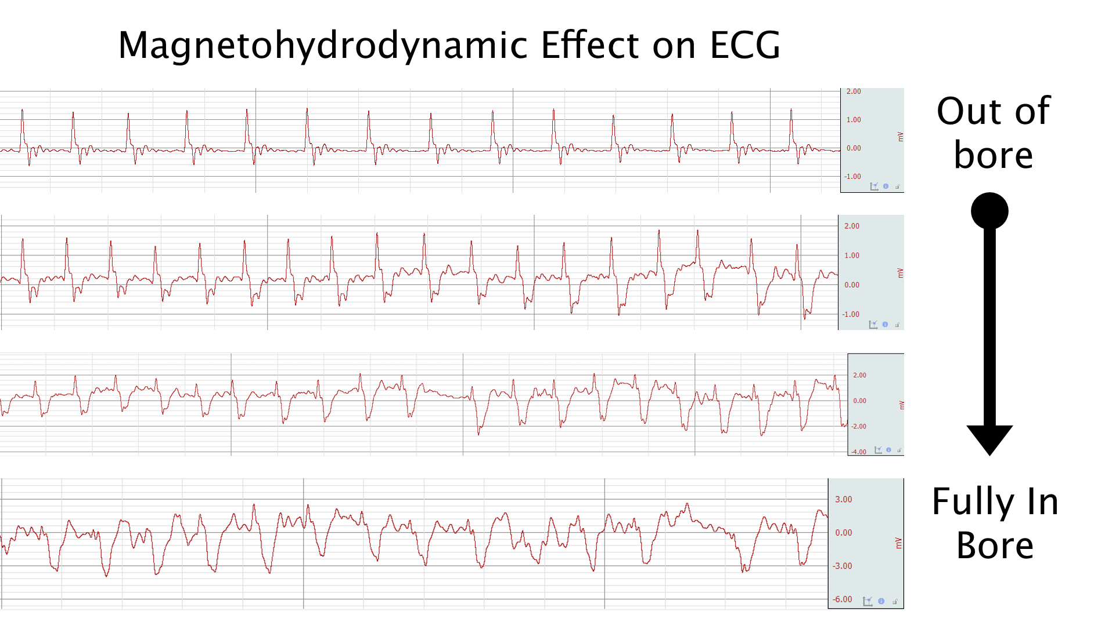
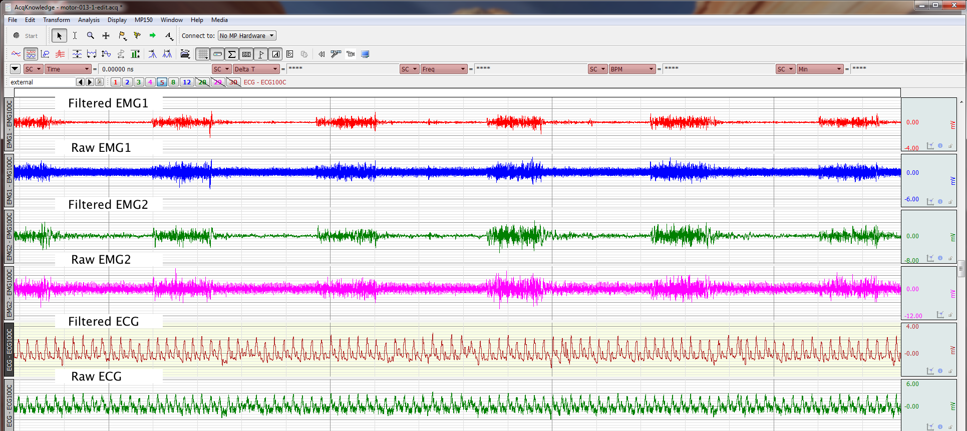
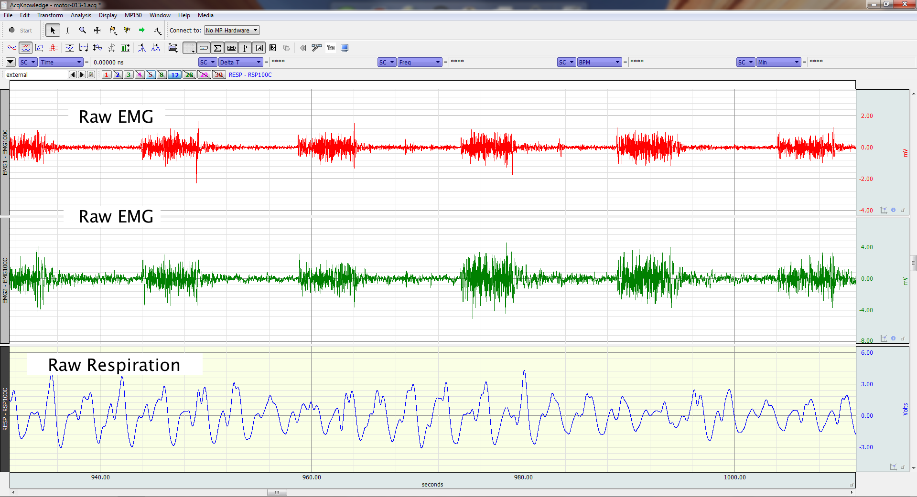
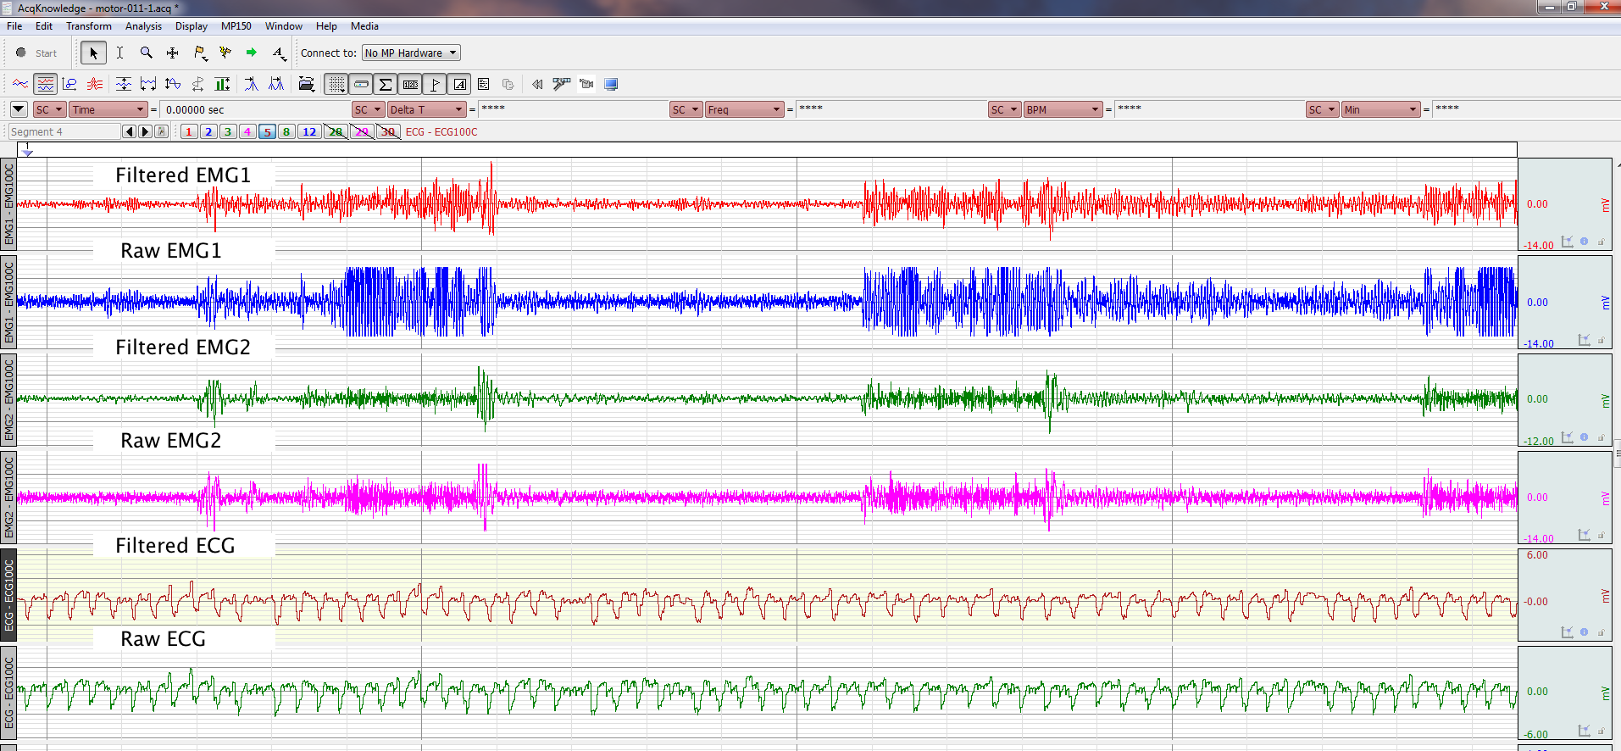
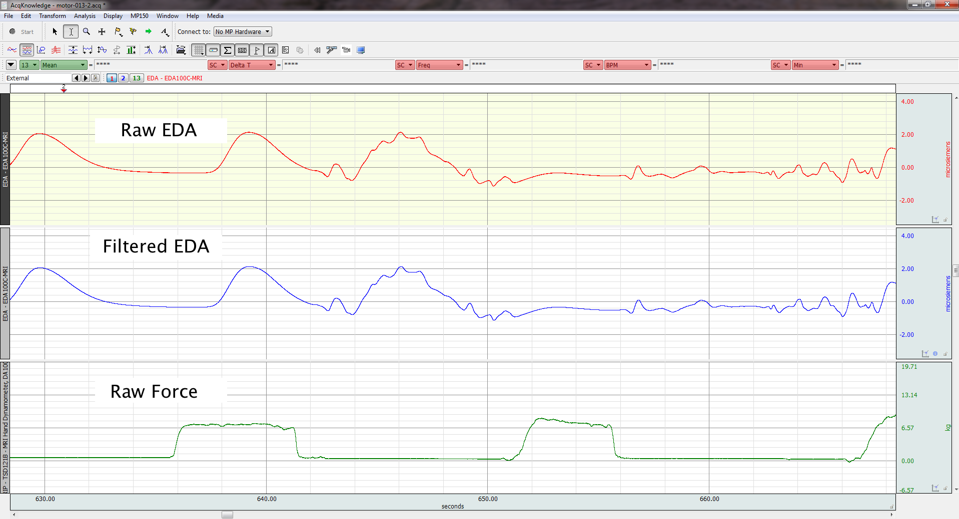


Neuropsychophysiological mapping: Concurrent psychophysiological recording and fMRI at 7T
Jennifer L. Robinson, Ph.D., Matthew Miller, Ph.D., Keith Lohse, Ph.D., Kirk Grand, Ashley C. Hill, Jerry E. Murphy, Lauren A. J. Kirby, Ken Graap, M.Ed.*, Alan Macy, M.S.E.E.*
*= Author is an employee of Biopac Systems, Inc. All other authors are affiliated with Auburn University
For reprint requests, please contact Jen Robinson at jrobinson@auburn.edu
BACKGROUND
FMRI PROCESSING
Background. In this study, we examine the effects of internal and external focus of attention during a hand-grip task under two contexts: social pressure, and no pressure. This is the first study of its kind to combine measures of peripheral (e.g., psychophysiological measurements) and central nervous system (functional magnetic resonance imaging [fMRI]) activity. Here, we present initial findings of multichannel psychophysiological data collection during submillimeter 7T fMRI.
Data were processed using FSL (http://fsl.fmrib.ox.ac.uk/fsl/fslwiki/). Standard preprocessing steps were completed including brain extraction, Gaussian smoothing (5mm FWHM), and slice timing correction. Data were also motion corrected, with outliers removed from subsequent GLM analyses (generated from fsl_motion_outliers). Regressors of interest were extracted physiological timecourses corresponding to the TRs. These included ECG, EDA, 2 channels of EMG (extensor and flexor muscles), and respiration. Force data were also included in the analyses. Group analyses were performed, controlling for within-subjects effects. Data were thresholded at cluster and voxel FDR-corrected p<0.05.
METHODS
RESULTS
Data were acquired in twelve adults using BIOPAC MRI-compatible modules, leads, and electrodes. FMRI scanning was performed on a 7T Siemens MAGNETOM. Electrocardiograph (ECG), respiration, electrodermal activity (EDA), electromyogram (EMG), and grip force were collected during simultaneous high-resolution fMRI.
FMRI was carried out using an echo-planar sequence consisting of 37 slices acquired parallel to the AC-PC line (0.85mmx0.85mmx1.5mm voxels, TR/TE: 3000/28ms, 70° flip angle, base/phase resolution 234/100, interleaved sequence).
FMRI Task. Participants were asked to complete a hand-gripping task under two testing conditions: once with social pressure, and once without any pressure. Testing sessions were counterbalanced across individuals.
Psychophysiology Preprocessing. EMG, EDA, and basic cardiovascular measures were derived after signal processing to remove scanning artifacts. EMG and EDA signals were reliably extracted and minimally affected by the simultaneous acquisition. For EMG data, a comb-band stop filter (12.33Hz and up to the Nyquist frequency) was applied. EDA data were subjected to a 10 Hz IIR low-pass filter to remove artifacts. Respiratory signals were largely unaffected. ECG signals were more vulnerable to scanning parameters, and highly distorted due to magnetohydrodynamic artifacts, thus a less automatic processing method was employed.
Effects of Filtering
FMRI Differences in Motor Control. Differences between the pressure and no pressure condition emerged for contrasts examining Squeeze > Rest Following Squeeze, and also for Rest Following Squeeze > Rest at the End of the Session. In both cases, the pressure condition elicited greater activation. For the Squeeze > Rest Following Squeeze, the pressure condition elicited greater activation throughout the parietal lobe, potentially suggesting a hypervigilance to sensory-motor integration (Table 1, Figure 1). Comparing different rest conditions (i.e., rest that immediately followed a motor trial versus rest at the end of the experiment), the pressure condition demonstrated greater activation throughout the brain, including regions involved in premotor planning (BA 6/8), decision making (BA 32), and somatosensory processing (BA 7/40) (Table 2, Figure 2).
FMRI Differences in Neuropsychophysiological Correlates. The only psychophysiological measurement that demonstrated differences in neural correlates between the pressure and no pressure condition was force. For force, the no pressure condition elicited greater activity throughout the parietal lobe, as well as in key subcortical structures such as the thalamus (Table 3). Because we did not find significant group differences, we collapsed across the two conditions, to look for consistent neural correlates of psychophysiological variables. Using this approach, two psychophysiological regressors demonstrated significant group effects: EMG corresponding to the flexor muscles and ECG (Tables 4/5, Figures 3/4, respectively).
Behavioral Performance. Participants made more errors in attempting to reach their target force (30% of max) during the pressure condition, compared to the no pressure condition (t (10) = 2.255, p < 0.05). Thus, we found support for “choking under pressure”, or stress.
CONCLUSIONS
We successfully collected submillimeter fMRI and multichannel psychophysiological data in an ultra-high field MR environment. Such data collection provides insight into the dynamic interactions of the central and autonomic nervous systems.
In the context of the present experiment, we found neurophysiological differences between the pressure and no pressure conditions, such that the pressure condition elicited greater activation during the motor task compared to the rest period immediately following it. Additionally, we found that the pressure condition elicited greater activation throughout the brain following each motor trial, suggesting that during the pressure condition, participants were using regions of the brain known to be involved in cognitive processing. These data suggest that participants may have been thinking more about their performance, and lend insight into potential neural networks that may be involved in the choking under pressure phenomenon.
Relationships between central and peripheral neurophysiological measures did not change between conditions. Collapsing across conditions, we found consistent neural correlates for ECG/EMG, but not for respiration/EDA. This may be due to lack of power, or variable neural correlates for these signals.

